Slide 1
Topic 9: Wave phenomena - AHL
9.5 – Doppler effect
Topic 9.5 is an extension of Topic 4.
Essential idea: The Doppler effect describes the phenomenon of wavelength/frequency shift when relative motion occurs.
Nature of science: Technology: Although originally based on physical observations of the pitch of fast moving sources of sound, the Doppler effect has an important role in many different areas such as evidence for the expansion of the universe and generating images used in weather reports and in medicine.
Notes:
© 2015 By Timothy K. Lund

Slide 2
Topic 9: Wave phenomena - AHL
9.5 – Doppler effect
Understandings:
• The Doppler effect for sound waves and light waves
Applications and skills:
• Sketching and interpreting the Doppler effect when there is relative motion between source and observer
• Describing situations where the Doppler effect can be utilized
• Solving problems involving the change in frequency or wavelength observed due to the Doppler effect to determine the velocity of the source/observer
Notes:
2
© 2015 By Timothy K. Lund

Slide 3
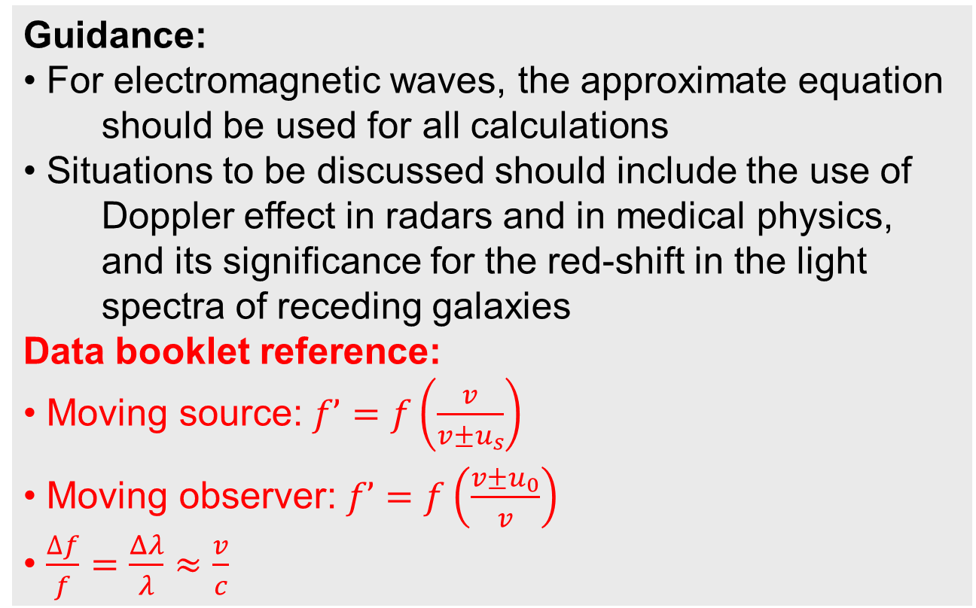
Topic 9: Wave phenomena - AHL
9.5 – Doppler effect
Guidance:
• For electromagnetic waves, the approximate equation should be used for all calculations
• Situations to be discussed should include the use of Doppler effect in radars and in medical physics, and its significance for the red-shift in the light spectra of receding galaxies
Data booklet reference:
• Moving source: $f’=f\left(\frac{v}{v±u_{s}}\right)$
• Moving observer: $f’=f\left(\frac{v±u_{0}}{v}\right)$
• $\frac{∆f}{f}=\frac{Δλ}{λ}≈\frac{v}{c}$
Notes:
3
© 2015 By Timothy K. Lund

Slide 4
Topic 9: Wave phenomena - AHL
9.5 – Doppler effect
International-mindedness:
• Radar usage is affected by the Doppler effect and must be considered for applications using this technology
Theory of knowledge:
• How important is sense perception in explaining scientific ideas such as the Doppler effect?
Utilization:
• Astronomy relies on the analysis of the Doppler effect when dealing with fast moving objects (see Physics option D)
Notes:
4
© 2015 By Timothy K. Lund

Slide 5
Topic 9: Wave phenomena - AHL
9.5 – Doppler effect
Aims:
• Aim 2: the Doppler effect needs to be considered in various applications of technology that utilize wave theory
• Aim 6: spectral data and images of receding galaxies are available from professional astronomical observatories for analysis
• Aim 7: computer simulations of the Doppler effect allow students to visualize complex and mostly unobservable situations
Notes:
5
© 2015 By Timothy K. Lund

Slide 6
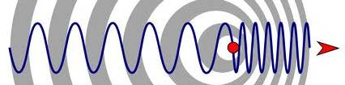
Topic 9: Wave phenomena - AHL
9.5 – Doppler effect
The Doppler effect – moving source
•The Doppler effect explains frequency change caused by moving sources or moving observers.
•For example, if a sound source of frequency f approaches you at a speed u_{S}, its wavefronts will bunch together and you will hear a frequency f ’ which is higher than f. ( f ’ > f ).
•On the other hand, if a sound source recedes from you at a speed u_{S}, its wavefronts will stretch out and you will hear a frequency f ’ which is lower than f. ( f ’ < f ).
f ’ < f
f ’ > f
u_{S}
Notes:
© 2015 By Timothy K. Lund

Slide 7
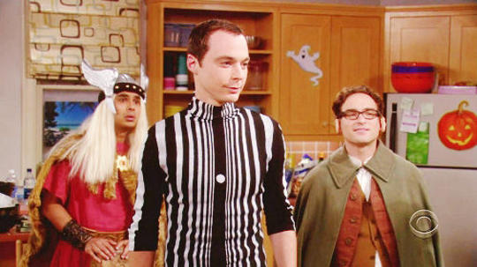
Topic 9: Wave phenomena - AHL
9.5 – Doppler effect
The Doppler effect – moving source
PRACTICE: Who claims he is wearing a Doppler effect costume?
SOLUTION:
Sheldon makes this claim.
Raj
Leonard
Sheldon
Notes:
© 2015 By Timothy K. Lund

Slide 8

Topic 9: Wave phenomena - AHL
9.5 – Doppler effect
The Doppler effect – moving source
•Consider the ice-cream truck that parks (u_{S} = 0) in the neighborhood playing that interminable music.
•Since the ice cream truck is not yet moving, the wave fronts are spherically symmetric.
the cross-section is symmetric.
u_{S} = 0
planar cross-section
u_{S} = 0
Notes:
© 2015 By Timothy K. Lund

Slide 9


Topic 9: Wave phenomena - AHL
9.5 – Doppler effect
The Doppler effect – moving source
•Whether Dobson is in front of the truck, or behind it, he hears the same frequency.
U_{S} = 0
FYI
•Even though the sound waves are drawn as transverse, they are actually longitudinal.
Notes:
© 2015 By Timothy K. Lund

Slide 10
Topic 9: Wave phenomena - AHL
9.5 – Doppler effect
The Doppler effect – moving source
•Suppose the ice-cream truck is now moving, but ringing the bell at the same rate as before.
•Note how the wave fronts bunch up in the front, and separate in the back.
•The reason this happens is that the truck moves forward a little bit during each successive spherical wave emission.
u_{S}
FYI
•Don’t forget, the actual speed of the wavefronts through the stationary medium of the air is the speed of sound v (bunched or otherwise).
Notes:
© 2015 By Timothy K. Lund

Slide 11
Topic 9: Wave phenomena - AHL
9.5 – Doppler effect
The Doppler effect – moving source
•Dobson will hear a different frequency now, depending on his position relative to the truck.
•If Dobson is in front of the moving truck, f ’ > f.
•If he is behind, he will hear f ’ < f.
f ’ < f
f ’ > f
u_{S}
Notes:
© 2015 By Timothy K. Lund

Slide 12
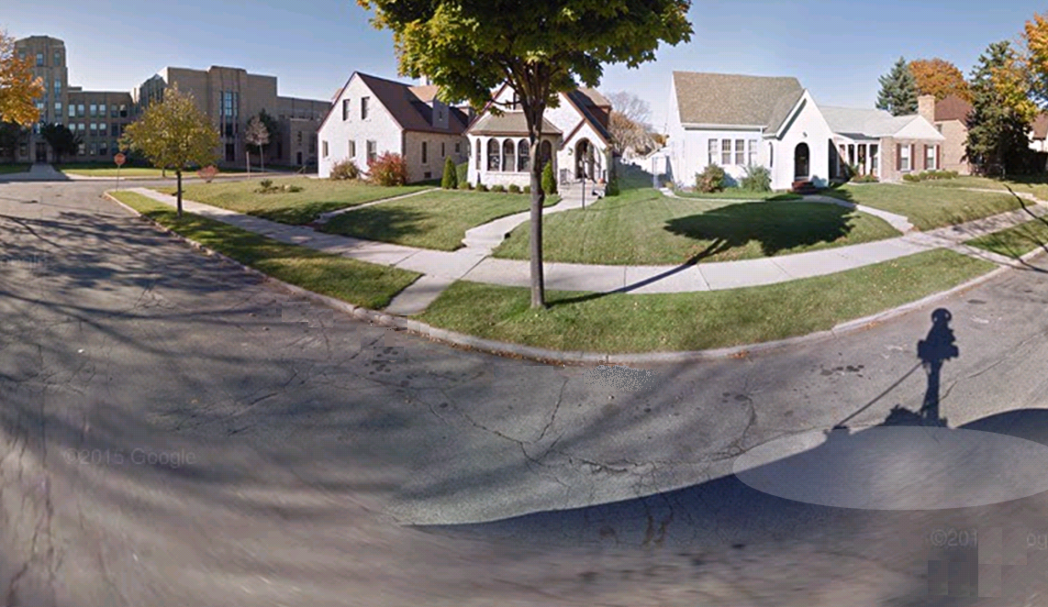


Topic 9: Wave phenomena - AHL
9.5 – Doppler effect
The Doppler effect – moving source
EXAMPLE: Dobson listens to the truck as it approaches, then as it recedes. Note what he hears!
Notes:
© 2015 By Timothy K. Lund

Slide 13
Topic 9: Wave phenomena - AHL
9.5 – Doppler effect
The Doppler effect – moving source
•Now we want to look at TWO successive pulses emitted by a source that is MOVING at speed u_{S}:
•λ is the “real” wavelength of the sound.
•Since the speed of sound in air is v, λ = vT where T is the period of the sound source. Note that Pulse 1 has traveled λ = vT in the time t = T.
λ = vT
Pulse 1
t = 0
Pulse 2
t = T
Pulse 1
t = T
λ’
u_{S}
d = u_{S}T
Notes:
© 2015 By Timothy K. Lund

Slide 14
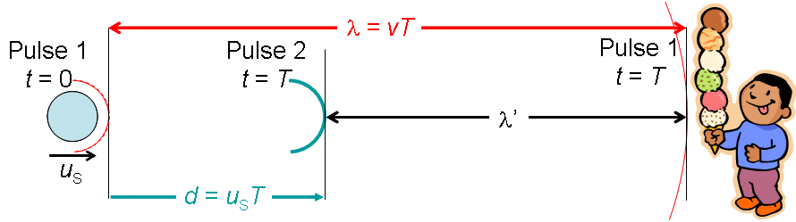
Topic 9: Wave phenomena - AHL
9.5 – Doppler effect
The Doppler effect – moving source
•λ’ is the wavelength detected by the observer.
•The distance d between the emission of the two pulses is simply the velocity of the source u_{S} times the time between emissions T. Thus d = u_{S}T.
•Since λ = d + λ’ then λ’ = λ – d = vT – u_{S}T. So
λ’ = (v – u_{S})T
Notes:
© 2015 By Timothy K. Lund

Slide 15


Topic 9: Wave phenomena - AHL
9.5 – Doppler effect
The Doppler effect – moving source
•From $v=λ’f’$ and $λ’=(v−u_{s})T$we see that
$f’=\frac{v}{λ^{′}} =\frac{v}{\left( v−u_{s}\right)T}$
$f’=\left(\frac{1}{T}\right)\left(\frac{v}{v−u_{s}}\right)$
$f’=f\left(\frac{v}{v−u_{s}}\right)$.
[ Since $f=\frac{1}{T}$]
FYI •If the source is receding, replace u_{S} with –u_{S}.
Notes:
© 2015 By Timothy K. Lund

Slide 16
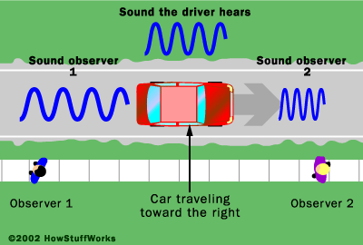


Topic 9: Wave phenomena - AHL
9.5 – Doppler effect
The Doppler effect – moving source
$$f’=f\left(\frac{v}{v ± uS}\right)$$
approach (-u_{S}), recede (+u_{S}).
Doppler effect moving source
EXAMPLE: A car horn has a frequency of 520 Hz. The car is traveling to the right at 25 ms⁻¹ and the speed of sound is 340 ms⁻¹.
(a) What frequency is heard by the driver?
SOLUTION:
•The driver has a relative speed of $uS=0$.
•Thus the driver hears $f’=520$Hz.
Notes:
© 2015 By Timothy K. Lund

Slide 17

Topic 9: Wave phenomena - AHL
9.5 – Doppler effect
The Doppler effect – moving source
$$f’=f\left(\frac{v}{v ± uS}\right)$$
approach (-u_{S}), recede (+u_{S}).
Doppler effect moving source
EXAMPLE: A car horn has a frequency of 520 Hz. The car is traveling to the right at 25 ms⁻¹ and the speed of sound is 340 ms⁻¹.
(b) What frequency is heard by Observer 1?
SOLUTION:
•For receding use +u_{S}. Then
$f’=520\left(\frac{340}{340+25}\right)=480$Hz. ( f’ is lower )
Notes:
© 2015 By Timothy K. Lund

Slide 18

Topic 9: Wave phenomena - AHL
9.5 – Doppler effect
The Doppler effect – moving source
$$f’=f\left(\frac{v}{v ± uS}\right)$$
approach (-u_{S}), recede (+u_{S}).
Doppler effect moving source
EXAMPLE: A car horn has a frequency of 520 Hz. The car is traveling to the right at 25 ms⁻¹ and the speed of sound is 340 ms⁻¹.
(c) What frequency is heard by Observer 2?
SOLUTION:
•For approach use –u_{S}. Then
$f’=520\left(\frac{340}{ 340–25}\right)=560$ Hz. ( f’ is higher )
Notes:
© 2015 By Timothy K. Lund

Slide 19
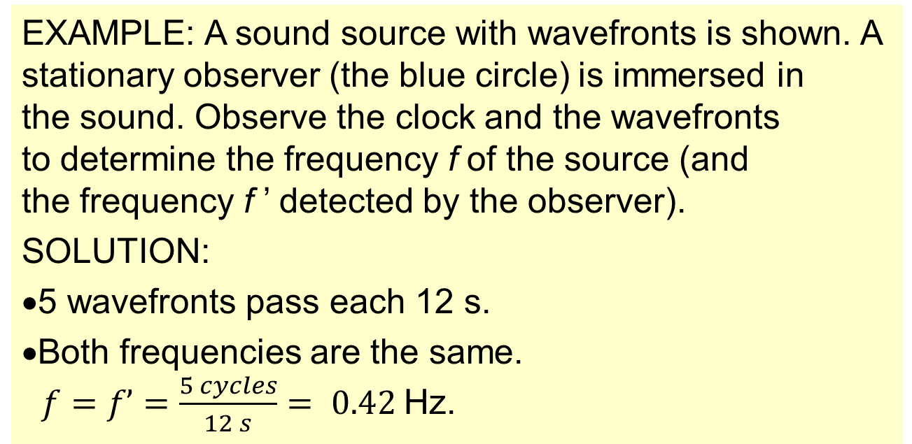
Topic 9: Wave phenomena - AHL
9.5 – Doppler effect
The Doppler effect – moving observer
•Suppose the source is stationary.
•If the observer is not moving, he will hear the true frequency of the source.
EXAMPLE: A sound source with wavefronts is shown. A stationary observer (the blue circle) is immersed in the sound. Observe the clock and the wavefronts to determine the frequency f of the source (and the frequency f ’ detected by the observer).
SOLUTION:
•5 wavefronts pass each 12 s.
•Both frequencies are the same.
$f=f’=\frac{5 cycles}{12 s}= 0.42$Hz.
o
Notes:
© 2015 By Timothy K. Lund

Slide 20
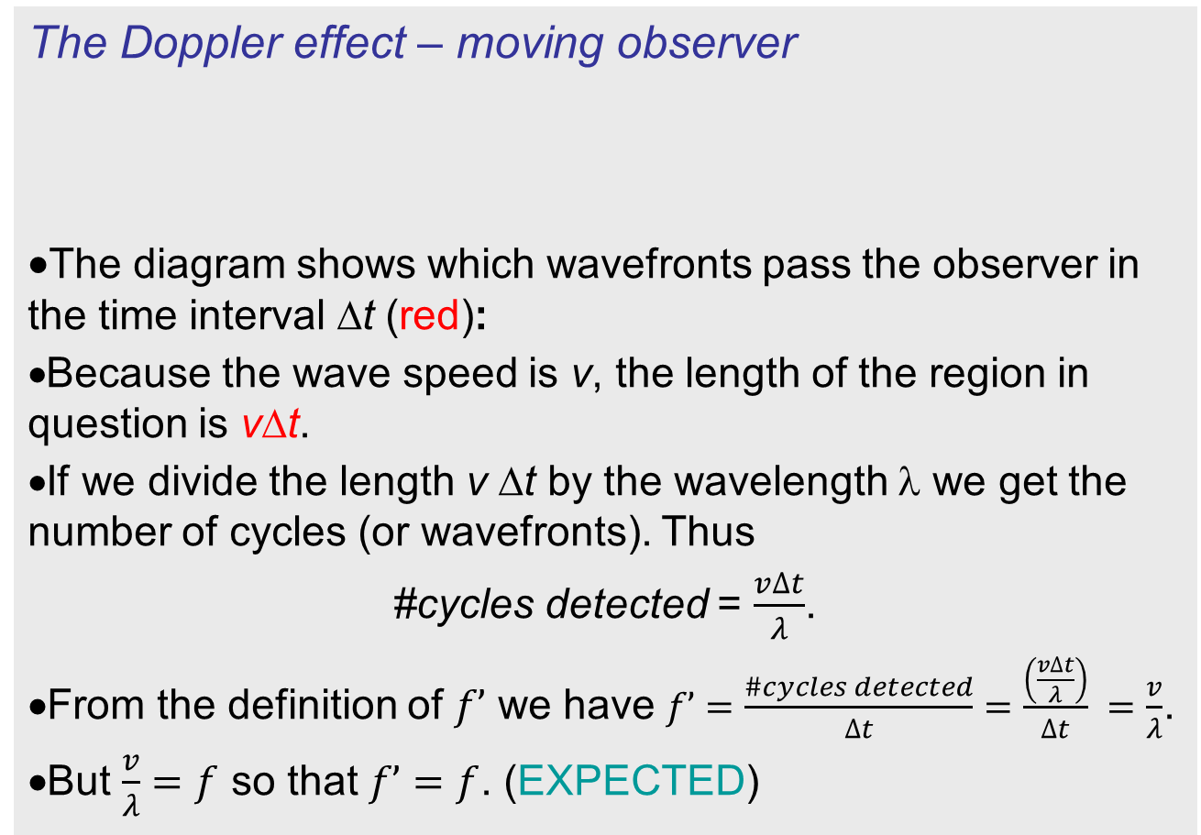
Topic 9: Wave phenomena - AHL
9.5 – Doppler effect
The Doppler effect – moving observer
•The diagram shows which wavefronts pass the observer in the time interval ∆t (red):
•Because the wave speed is v, the length of the region in question is v∆t.
•If we divide the length v ∆t by the wavelength λ we get the number of cycles (or wavefronts). Thus
#cycles detected = $\frac{v∆t}{λ}$.
•From the definition of $f’$ we have $f’=\frac{\#cycles detected}{∆t}=\frac{\left(\frac{v∆t}{λ}\right)}{∆t} =\frac{v}{λ}$.
•But $\frac{v}{λ}=f$ so that $f’=f$. (EXPECTED)
o
v ∆t
Notes:
© 2015 By Timothy K. Lund

Slide 21
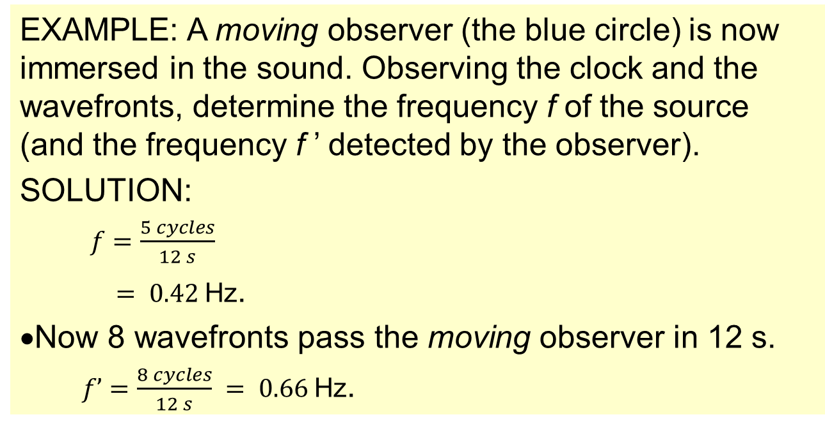
Topic 9: Wave phenomena - AHL
9.5 – Doppler effect
The Doppler effect – moving observer
•Suppose the source is stationary.
•If the observer is moving TOWARD the source at u_{O}, he will hear a higher frequency.
EXAMPLE: A moving observer (the blue circle) is now immersed in the sound. Observing the clock and the wavefronts, determine the frequency f of the source (and the frequency f ’ detected by the observer).
SOLUTION:
$f =\frac{5 cycles}{12 s}$
$= 0.42$Hz.
•Now 8 wavefronts pass the moving observer in 12 s.
$f’ =\frac{8 cycles}{12 s} = 0.66$Hz.
o
Notes:
© 2015 By Timothy K. Lund

Slide 22
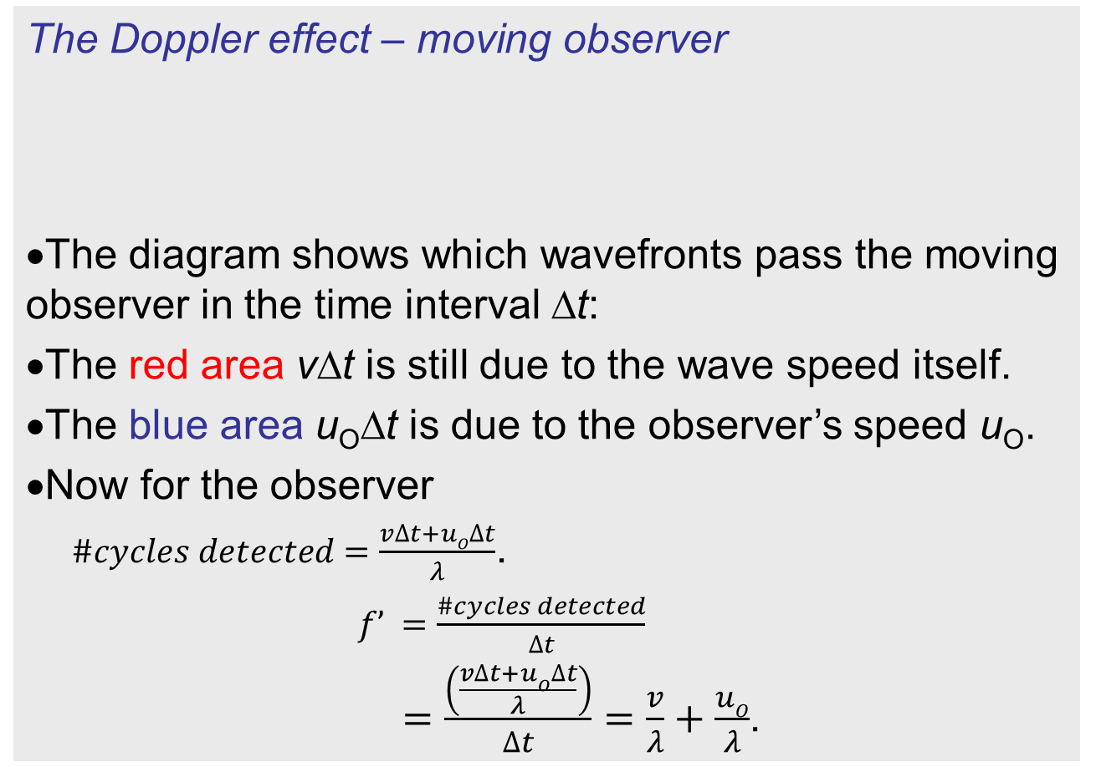
Topic 9: Wave phenomena - AHL
9.5 – Doppler effect
The Doppler effect – moving observer
•The diagram shows which wavefronts pass the moving observer in the time interval ∆t:
•The red area v∆t is still due to the wave speed itself.
•The blue area u_{O}∆t is due to the observer’s speed u_{O}.
•Now for the observer
$\#cycles detected =\frac{v∆t+uO∆t}{λ}$.
$f’ =\frac{\#cycles detected}{∆t}$
$=\frac{\left(\frac{v∆t+uO∆t}{λ}\right)}{∆t}=\frac{v}{λ}+\frac{uO}{λ}$.
o
v∆t
u_{O}∆t
Notes:
© 2015 By Timothy K. Lund

Slide 23

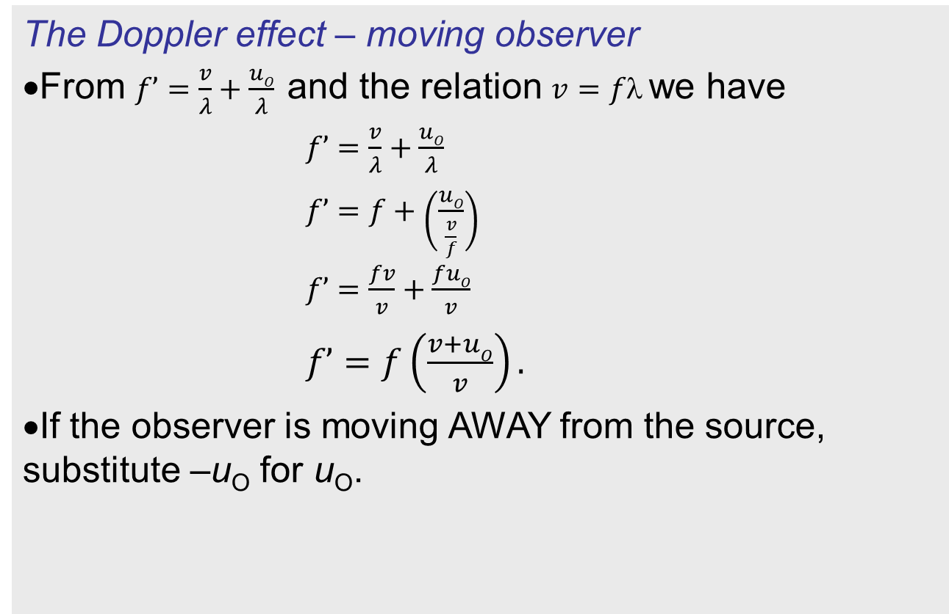
Topic 9: Wave phenomena - AHL
9.5 – Doppler effect
The Doppler effect – moving observer
•From $f’=\frac{v}{λ}+\frac{uO}{λ}$and the relation $v=f$we have
$f’=\frac{v}{λ}+\frac{uO}{λ}$
$f’=f+\left(\frac{uO}{\frac{v}{f}}\right)$
$f’=\frac{fv}{v}+\frac{fuO}{v}$
$f’=f\left(\frac{v+uO}{v}\right).$
•If the observer is moving AWAY from the source, substitute –u_{O} for u_{O}.
$$f’=f\left(\frac{v± u_{o}}{v }\right)$$
approach (+u₀), recede (-u₀).
Doppler effect moving observer
FYI: Always pick the sign that makes f ’ do what is expected.
Notes:
© 2015 By Timothy K. Lund

Slide 24

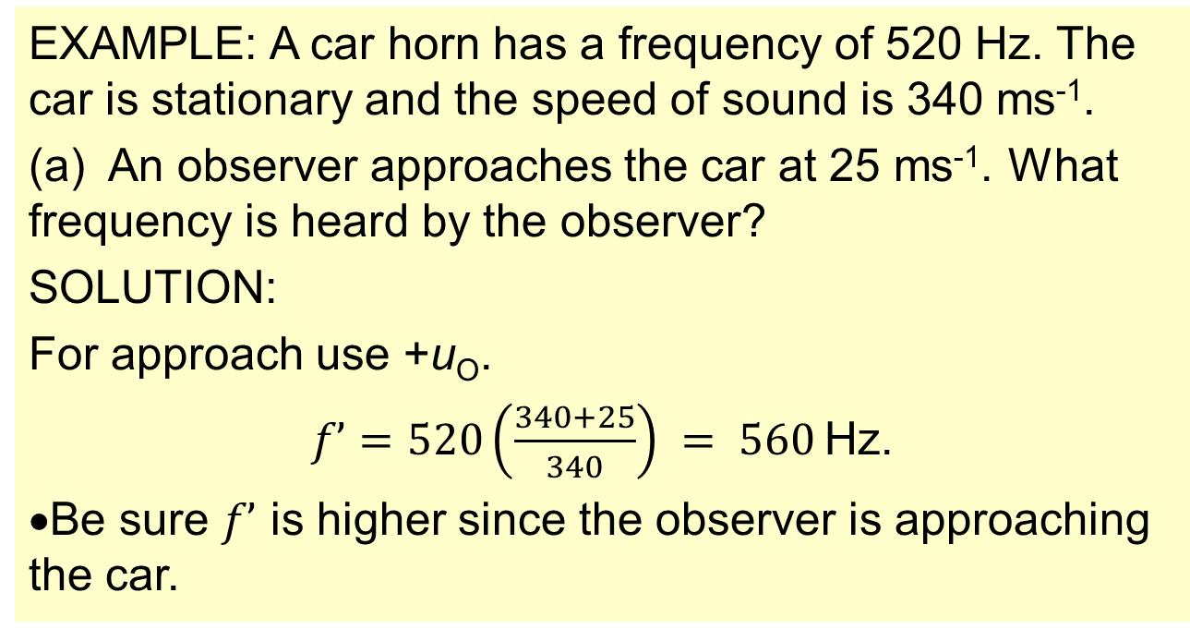
Topic 9: Wave phenomena - AHL
9.5 – Doppler effect
The Doppler effect – moving observer
$$f’=f\left(\frac{v± u_{o}}{v }\right)$$
approach (-u₀), recede (+u₀).
Doppler effect moving observer
EXAMPLE: A car horn has a frequency of 520 Hz. The car is stationary and the speed of sound is 340 ms⁻¹.
(a) An observer approaches the car at 25 ms⁻¹. What frequency is heard by the observer?
SOLUTION:
For approach use +u_{O}.
$f’=520\left(\frac{340+25}{340}\right) = 560$Hz.
•Be sure $f’$ is higher since the observer is approaching the car.
Notes:
© 2015 By Timothy K. Lund

Slide 25

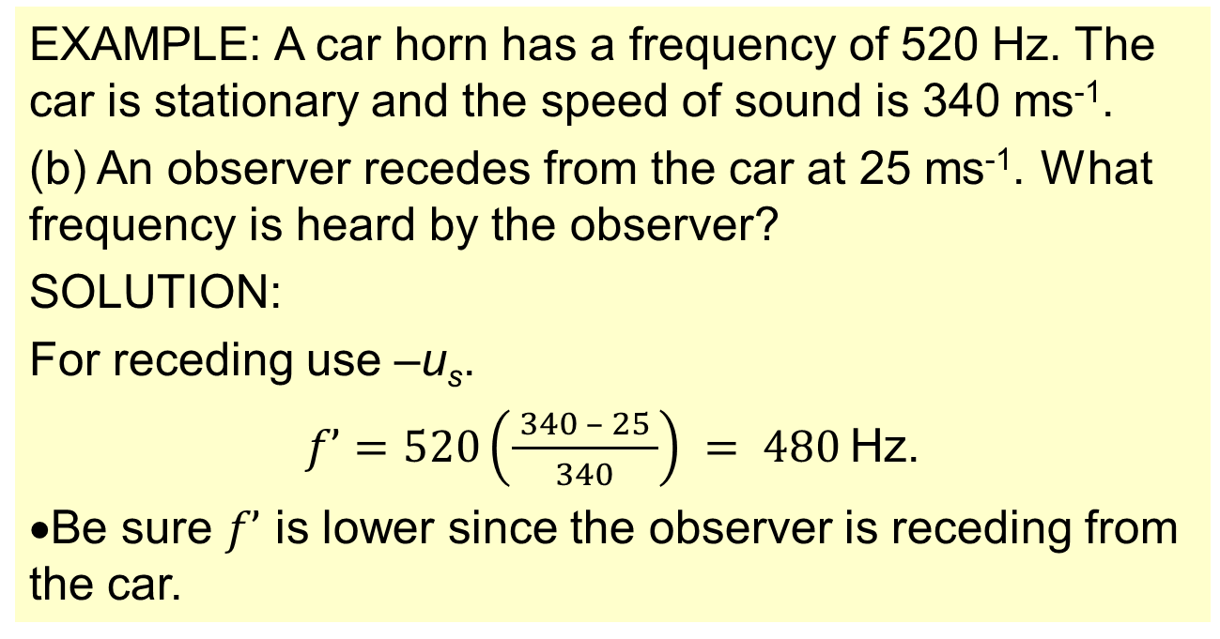
Topic 9: Wave phenomena - AHL
9.5 – Doppler effect
The Doppler effect – moving observer
$$f’=f\left(\frac{v± u_{o}}{v }\right)$$
approach (-u₀), recede (+u₀).
Doppler effect moving observer
EXAMPLE: A car horn has a frequency of 520 Hz. The car is stationary and the speed of sound is 340 ms⁻¹.
(b) An observer recedes from the car at 25 ms⁻¹. What frequency is heard by the observer?
SOLUTION:
For receding use –u_{s}.
$f’=520\left(\frac{ 340 – 25 }{340}\right) = 480$Hz.
•Be sure $f’$ is lower since the observer is receding from the car.
Notes:
© 2015 By Timothy K. Lund

Slide 26
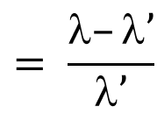


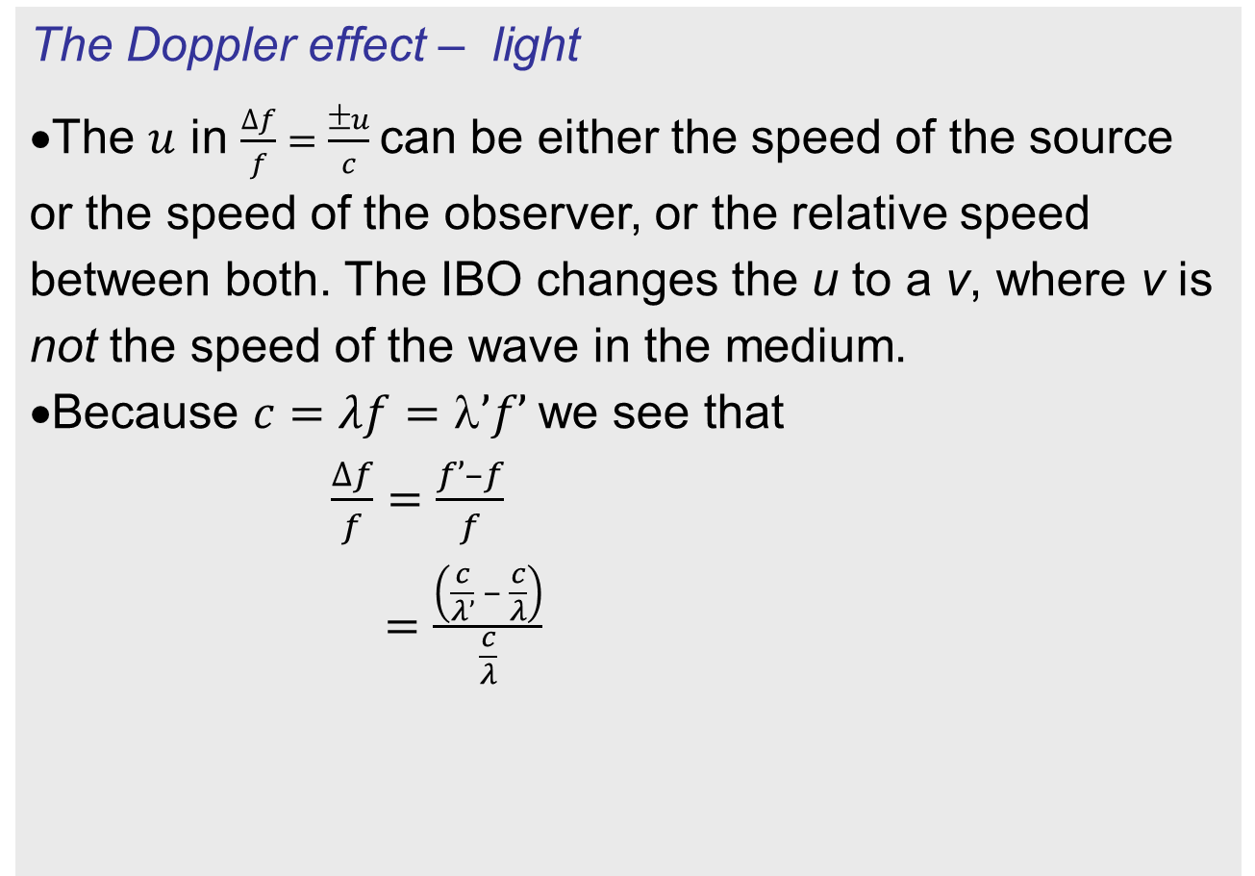

Topic 9: Wave phenomena - AHL
9.5 – Doppler effect
The Doppler effect – light
•The $u$ in $\frac{∆f}{f}=\frac{±u}{c}$can be either the speed of the source or the speed of the observer, or the relative speed between both. The IBO changes the u to a v, where v is not the speed of the wave in the medium.
•Because $c=λf=’f’$we see that
$\frac{∆f}{f}=\frac{f’–f}{f}$
$=\frac{\left(\frac{c}{λ’} – \frac{c}{λ}\right)}{\frac{c}{λ}}$
$$= \frac{λ}{λ’}–1$$
$$= \frac{λ–λ’}{λ’}$$
$$= \frac{∆λ}{λ}$$
$$\frac{∆f}{f}=\frac{∆λ}{λ}=\frac{v}{c}$$
v is the relative speed between source and observer
Doppler effect for light
Notes:
© 2015 By Timothy K. Lund

Slide 27
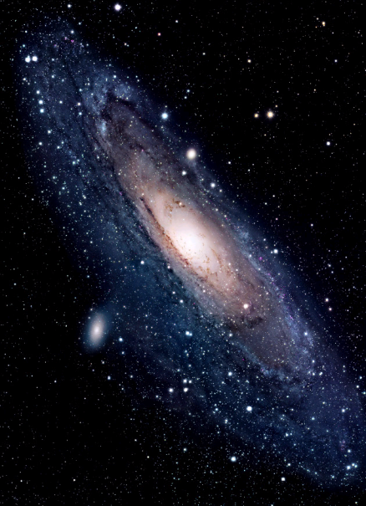
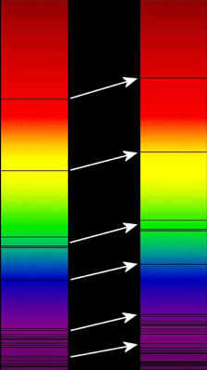
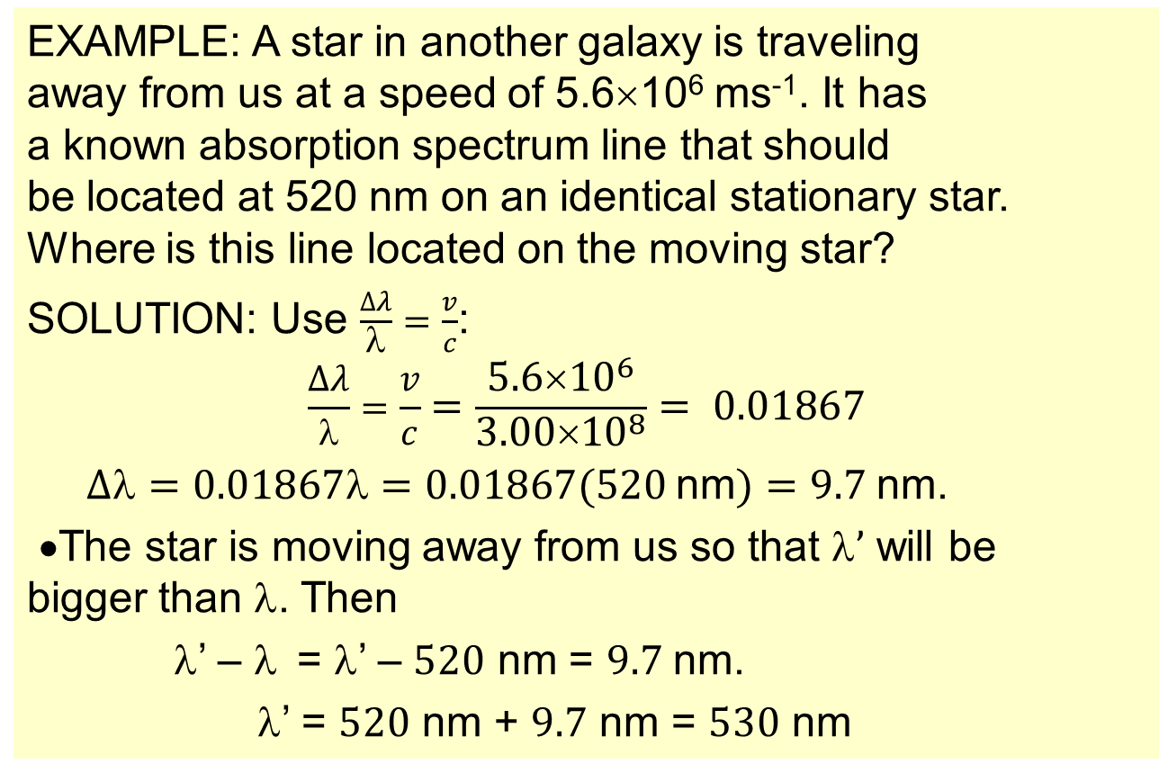
Topic 9: Wave phenomena - AHL
9.5 – Doppler effect
The Doppler effect – light
EXAMPLE: A star in another galaxy is traveling away from us at a speed of 5.6×10⁶ ms⁻¹. It has a known absorption spectrum line that should be located at 520 nm on an identical stationary star. Where is this line located on the moving star?
SOLUTION: Use $\frac{∆λ}{λ}=\frac{v}{c}$:
$$\frac{∆λ}{λ}=\frac{v}{c}=\frac{5.6×{10}^{6}}{3.00×{10}^{8}}= 0.01867$$
$∆=0.01867=0.01867(520$nm$)=9.7$nm.
•The star is moving away from us so that $’$ will be bigger than λ. Then
λ’ – λ = λ’ – $520$ nm = $9.7$nm.
λ’ = $520$ nm + $9.7$ nm = $530$ nm
Notes:
© 2015 By Timothy K. Lund

Slide 28
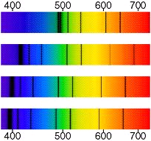
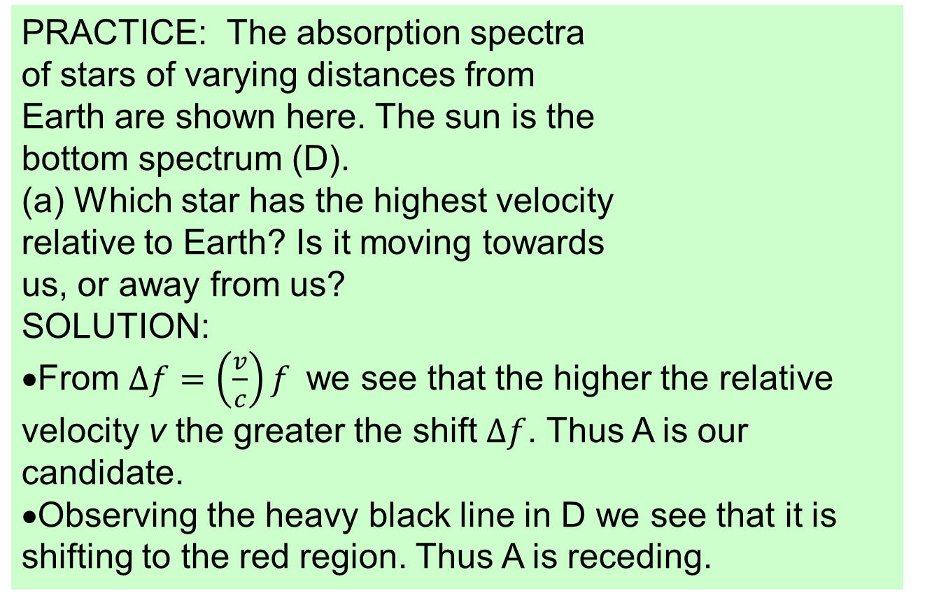
Topic 9: Wave phenomena - AHL
9.5 – Doppler effect
A
The Doppler effect – light
B
PRACTICE: The absorption spectra of stars of varying distances from Earth are shown here. The sun is the bottom spectrum (D).
(a) Which star has the highest velocity relative to Earth? Is it moving towards us, or away from us?
SOLUTION:
•From $∆f=\left(\frac{v}{c}\right)f$we see that the higher the relative velocity v the greater the shift $∆f$. Thus A is our candidate.
•Observing the heavy black line in D we see that it is shifting to the red region. Thus A is receding.
C
D
Notes:
© 2015 By Timothy K. Lund

Slide 29
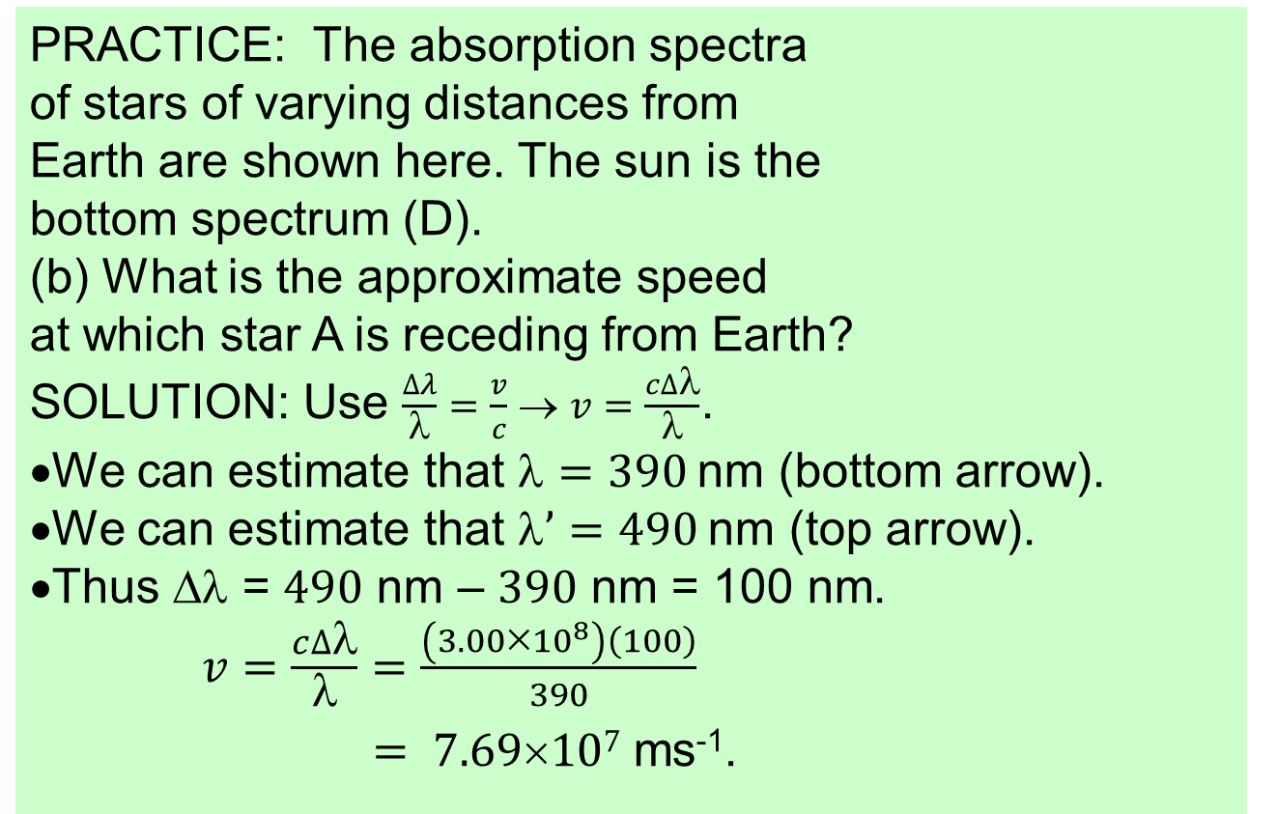
Topic 9: Wave phenomena - AHL
9.5 – Doppler effect
A
The Doppler effect – light
B
PRACTICE: The absorption spectra of stars of varying distances from Earth are shown here. The sun is the bottom spectrum (D).
(b) What is the approximate speed at which star A is receding from Earth?
SOLUTION: Use $\frac{∆λ}{λ}=\frac{v}{c}$ → $v=\frac{c∆λ}{λ}$.
•We can estimate that $=390$nm (bottom arrow).
•We can estimate that $’=490$nm (top arrow).
•Thus ∆λ = $490$ nm – $390$ nm = 100 nm.
$v=\frac{c∆λ}{λ}=\frac{\left(3.00×{10}^{8}\right)\left(100\right)}{390}$
$= 7.69107$ ms⁻¹.
C
D
This is the so-called “redshift” and it is used as evidence for an expanding universe.
Notes:
© 2015 By Timothy K. Lund

Slide 30
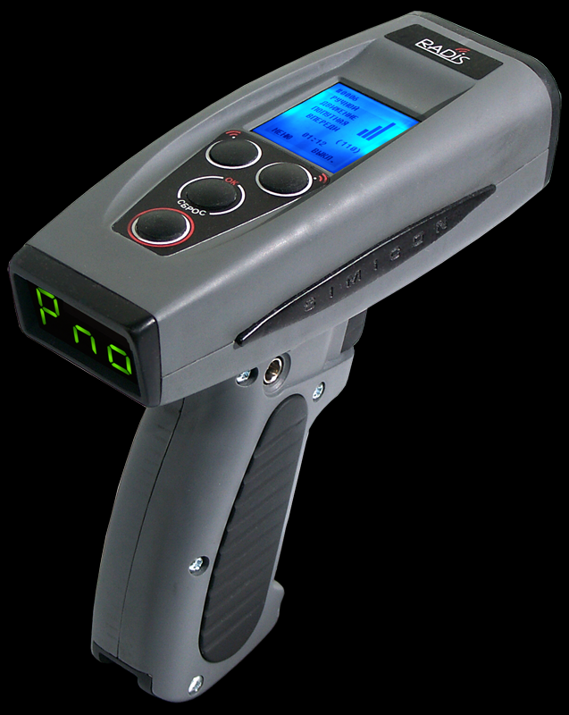
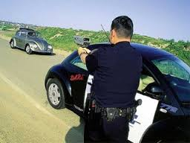
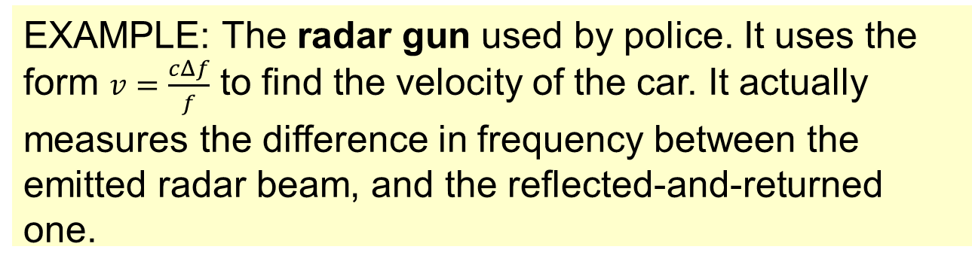
Topic 9: Wave phenomena - AHL
9.5 – Doppler effect
Situations where the Doppler effect can be utilized
EXAMPLE: The radar gun used by police. It uses the form $v=\frac{cΔf}{f}$ to find the velocity of the car. It actually measures the difference in frequency between the emitted radar beam, and the reflected-and-returned one.
Notes:
© 2015 By Timothy K. Lund

Slide 31
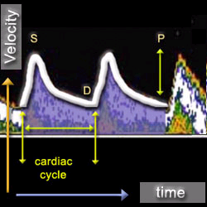
Topic 9: Wave phenomena - AHL
9.5 – Doppler effect
Situations where the Doppler effect can be utilized
EXAMPLE: A Doppler ultrasound test uses reflected sound waves to see how blood flows through a blood vessel. It helps doctors evaluate blood flow through major arteries and veins, such as those of the arms, legs, and neck. It can show blocked or reduced blood flow through narrowing in the major arteries of the neck that could cause a stroke. It also can reveal blood clots in leg veins (deep vein thrombosis, or DVT) that could break loose and block blood flow to the lungs (pulmonary embolism).
Notes:
© 2015 By Timothy K. Lund

Slide 32
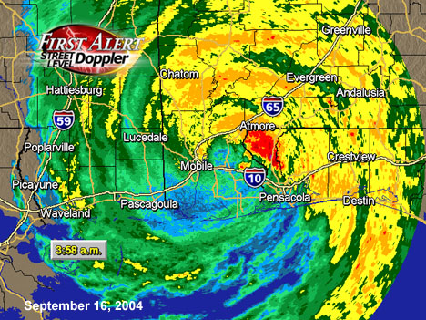
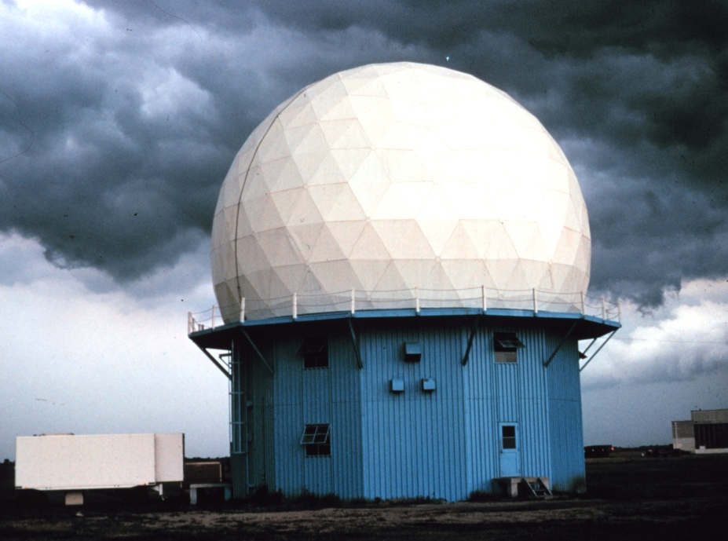
Topic 9: Wave phenomena - AHL
9.5 – Doppler effect
Situations where the Doppler effect can be utilized
EXAMPLE: A Doppler weather radar is a specialized radar that makes use of the Doppler effect to produce velocity data about objects at a distance. It does this by beaming a microwave signal towards a desired target and listening for its reflection, then analyzing how the frequency of the returned signal has been altered by the storm’s motion. This variation gives accurate measurements of the radial component of a storm’s velocity.
Notes:
© 2015 By Timothy K. Lund

Slide 33
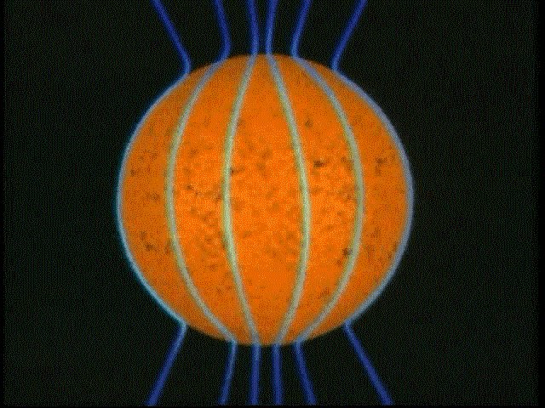

Topic 9: Wave phenomena - AHL
9.5 – Doppler effect
Situations where the Doppler effect can be utilized
EXAMPLE: If you look at a rotating luminous object like the sun, you see that one side is moving away from the observer while the other side is approaching the observer. Once again, the formula $v=\frac{c∆f}{f}$ comes into play. The sun’s right side will be red shifted, whereas the left will be blue shifted. We can then find the speed of rotation of the sun (or any star, even if it is quite distant).
Notes:
© 2015 By Timothy K. Lund

Slide 34

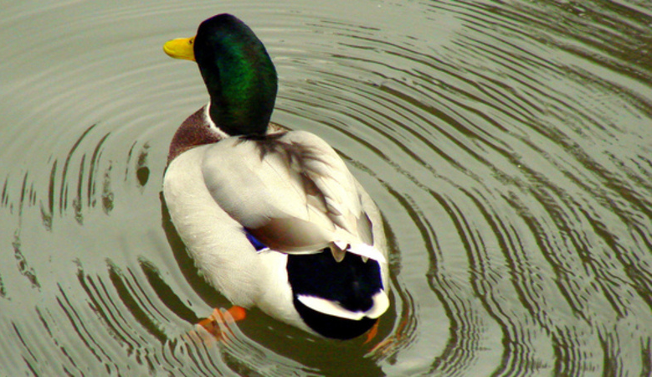
Topic 9: Wave phenomena - AHL
9.5 – Doppler effect
Solve problems involving the Doppler effect
•Since the source is receding λ’ had better increase.
•It will increase by how far d = VT the source has traveled.
•Note that the source is NOT traveling at v, the speed of sound!
Notes:
© 2015 By Timothy K. Lund

Slide 35
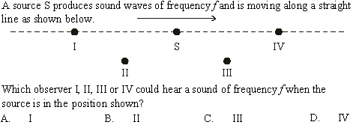
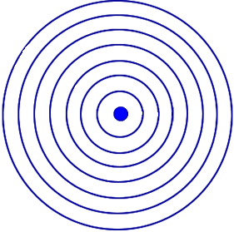
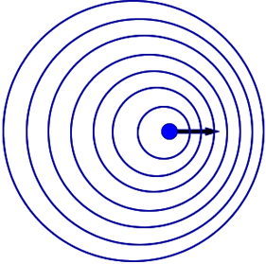
Topic 9: Wave phenomena - AHL
9.5 – Doppler effect
Solve problems involving the Doppler effect
•Consider both the stationary and moving source S.
•By placing a scale from the first diagram into the second…
Notes:
© 2015 By Timothy K. Lund

Slide 36
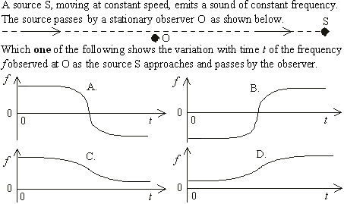
•Frequency will decrease as S passes O. Why?
Topic 9: Wave phenomena - AHL
9.5 – Doppler effect
Solve problems involving the Doppler effect
•A is wrong because f goes negative. Beware!
Notes:
© 2015 By Timothy K. Lund

Slide 37
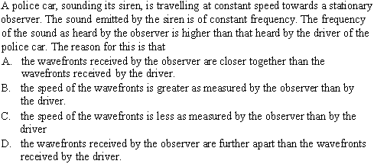
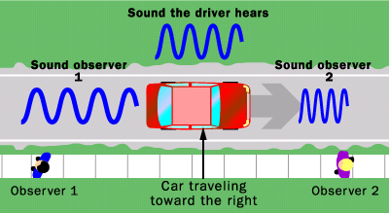
Topic 9: Wave phenomena - AHL
9.5 – Doppler effect
Solve problems involving the Doppler effect
Notes:
© 2015 By Timothy K. Lund

Slide 38
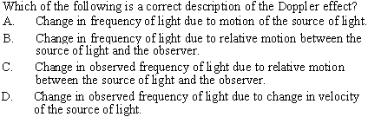
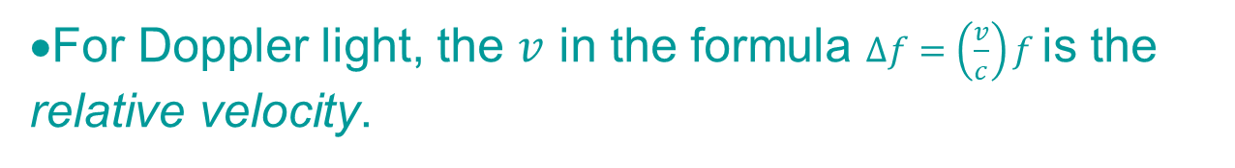
Topic 9: Wave phenomena - AHL
9.5 – Doppler effect
Solve problems involving the Doppler effect
•Because the speed of light is a constant c regardless of the speed of the source of the light, its frequency cannot change.
•The Doppler effect has nothing to do with “change in velocity.”
•For Doppler light, the $v$ in the formula $∆f=\left(\frac{v}{c}\right)f$is the relative velocity.
Notes:
© 2015 By Timothy K. Lund

Slide 39
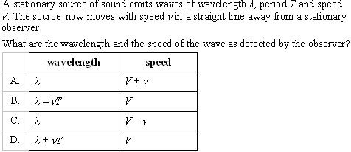
Topic 9: Wave phenomena - AHL
9.5 – Doppler effect
Solve problems involving the Doppler effect
•For moving away the wavelength INCREASES.
FYI •Regardless of who is observing, the speed of the wave is determined by the air, and nothing else. Thus the speed is V.
Notes:
© 2015 By Timothy K. Lund

Slide 40



Topic 9: Wave phenomena - AHL
9.5 – Doppler effect
Solve problems involving the Doppler effect
•For moving observer we use $f’=f\frac{v+uO}{v}$.
•In terms of the given symbols $f=fO\frac{v+0.1v}{v}$.
•Thus $f=1.1fO$if the observer O and the source S are perfectly IN-LINE. They are not. Thus B is the answer.
Notes:
© 2015 By Timothy K. Lund

