Slide 1
Topic 7: Atomic, nuclear and particle physics 7.3 – The structure of matter
Essential idea: It is believed that all the matter around us is made up of fundamental particles called quarks and leptons. It is known that matter has a hierarchical structure with quarks making up nucleons, nucleons making up nuclei, nuclei and electrons making up atoms and atoms making up molecules. In this hierarchical structure, the smallest scale is seen for quarks and leptons (10⁻¹⁸ m).
Notes:
© 2006 By Timothy K. Lund

Slide 2
Topic 7: Atomic, nuclear and particle physics 7.3 – The structure of matter
Nature of science: (1) Predictions: Our present understanding of matter is called the standard model, consisting of six quarks and six leptons. Quarks were postulated on a completely mathematical basis in order to explain patterns in properties of particles. (2) Collaboration: It was much later that large-scale collaborative experimentation led to the discovery of the predicted fundamental particles.
Notes:
2
© 2006 By Timothy K. Lund

Slide 3
Topic 7: Atomic, nuclear and particle physics 7.3 – The structure of matter
Understandings:
• Quarks, leptons and their antiparticles
• Hadrons, baryons and mesons
• The conservation laws of charge, baryon number, lepton number and strangeness
• The nature and range of the strong nuclear force, weak nuclear force and electromagnetic force
• Exchange particles
• Feynman diagrams
• Confinement
• The Higgs boson
Notes:
3
© 2006 By Timothy K. Lund

Slide 4
Topic 7: Atomic, nuclear and particle physics 7.3 – The structure of matter
Applications and skills:
• Describing the Rutherford-Geiger-Marsden experiment that led to the discovery of the nucleus
• Applying conservation laws in particle reactions
• Describing protons and neutrons in terms of quarks
• Comparing the interaction strengths of the fundamental forces, including gravity
• Describing the mediation of the fundamental forces through exchange particles
• Sketching and interpreting simple Feynman diagrams
• Describing why free quarks are not observed
Notes:
4
© 2006 By Timothy K. Lund

Slide 5
Topic 7: Atomic, nuclear and particle physics 7.3 – The structure of matter
Guidance:
• A description of the standard model is required
Data booklet reference:
• The quarks
Notes:
5
© 2006 By Timothy K. Lund

Slide 6
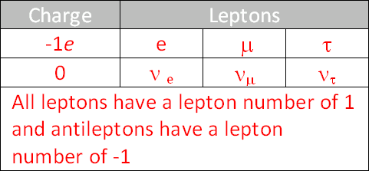
Topic 7: Atomic, nuclear and particle physics 7.3 – The structure of matter
Data booklet reference:
• The leptons
• The exchange particles
Notes:
6
© 2006 By Timothy K. Lund

Slide 7
Topic 7: Atomic, nuclear and particle physics 7.3 – The structure of matter
International-mindedness:
• Research into particle physics requires ever-increasing funding, leading to debates in governments and international research organizations on the fair allocation of precious financial resources
Theory of knowledge:
• Does the belief in the existence of fundamental particles mean that it is justifiable to see physics as being more important than other areas of knowledge?
Notes:
7
© 2006 By Timothy K. Lund

Slide 8
Topic 7: Atomic, nuclear and particle physics 7.3 – The structure of matter
Utilization:
• An understanding of particle physics is needed to determine the final fate of the universe (see Physics option sub-topics D.3 and D.4)
Aims:
• Aim 1: the research that deals with the fundamental structure of matter is international in nature and is a challenging and stimulating adventure for those who take part
• Aim 4: particle physics involves the analysis and evaluation of very large amounts of data
Notes:
8
© 2006 By Timothy K. Lund

Slide 9
Topic 7: Atomic, nuclear and particle physics 7.3 – The structure of matter
Aims:
• Aim 6: students could investigate the scattering angle of alpha particles as a function of the aiming error, or the minimum distance of approach as a function of the initial kinetic energy of the alpha particle
• Aim 8: scientific and government organizations are asked if the funding for particle physics research could be spent on other research or social needs
Notes:
9
© 2006 By Timothy K. Lund

Slide 10
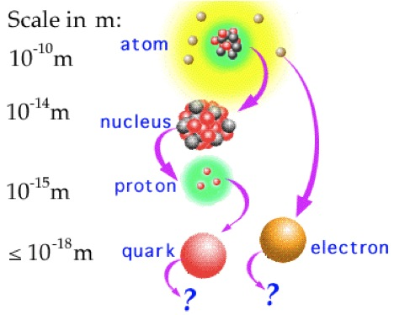
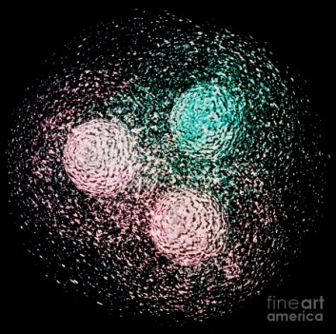
Topic 7: Atomic, nuclear and particle physics 7.3 – The structure of matter
Description and classification of particles
•An elementary particle has no internal structure.
PRACTICE: At one time it was thought that atoms were elementary particles. Explain why they are not.
SOLUTION: They have an internal structure: Namely protons, neutrons and electrons.
EXAMPLE: At one time it was thought that protons and neutrons were elementary particles. Explain why they are not.
SOLUTION: Protons and neutrons are each built from three elementary particles called quarks.
Notes:
© 2006 By Timothy K. Lund

Slide 11
Topic 7: Atomic, nuclear and particle physics 7.3 – The structure of matter
Description and classification of particles
•To date there are three major divisions in the elementary particles.
•The force carriers are the particles that allow compatible particles to sense and react to each other’s presence through exchange of these carriers.
•The quarks are the heavier, tightly bound particles that make up particles like protons and neutrons.
•The leptons are the lighter, more loosely bound particles like electrons.
FYI •For example, quarks interact via the strong force particles called gluons.
Notes:
© 2006 By Timothy K. Lund

Slide 12
Topic 7: Atomic, nuclear and particle physics 7.3 – The structure of matter
The nature and range of the force carriers
•There are four force carriers…
•INTERACTION 1: STRONG:
Strongest of all the interactions between particles. We can give it an arbitrary value of 1.0 for comparison.
•INTERACTION 2: ELECTROMAGNETIC:
This is the NEXT strongest. In comparison to the strong interaction, it has a relative strength of 10 ⁻².
•INTERACTION 3: WEAK:
This interaction has a relative strength of 10 ⁻⁶.
•INTERACTION 4: GRAVITATIONAL:
This interaction has a relative strength of 10 ⁻³⁹.
1.0
0.01
0.000001
0.000000000000000000000000000000000000001
Notes:
© 2006 By Timothy K. Lund

Slide 13
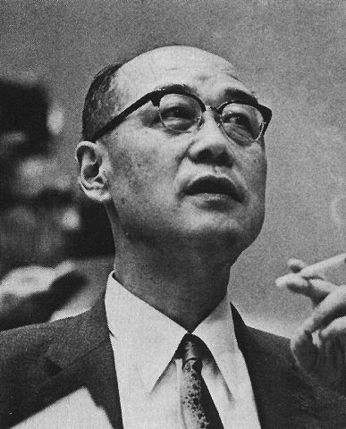
Topic 7: Atomic, nuclear and particle physics 7.3 – The structure of matter
The nature and range of the force carriers
•In 1933 Hideki Yukawa developed the theory of exchange forces.
•The basic idea is that all forces are due to the exchange of particles between like elementary particles.
•Consider two protons in space.
•Yukawa postulated that the protons exchange photons and repel each other because of this exchange.
FYI
•This photon exchange is the electromagnetic force.
Notes:
© 2006 By Timothy K. Lund

Slide 14
Topic 7: Atomic, nuclear and particle physics 7.3 – The structure of matter
The nature and range of the force carriers
•Yukawa explained that the electromagnetic force was long range (in fact infinite in range) because photons "live forever" until they are absorbed.
•Yukawa explained that the strong force was short range (in fact only in the nuclear range) because the strong force exchange particle (the gluon) has a very short life.
LONG RANGE EXCHANGE PARTICLE
SHORT RANGE EXCHANGE (VIRTUAL) PARTICLE
Notes:
© 2006 By Timothy K. Lund

Slide 15
Topic 7: Atomic, nuclear and particle physics 7.3 – The structure of matter
The nature and range of the force carriers
•Exchange particles whose range of influence is limited are called virtual particles.
•Virtual particles can only exist within their range of influence.
Notes:
15
© 2006 By Timothy K. Lund

Slide 16
Topic 7: Atomic, nuclear and particle physics 7.3 – The structure of matter
Quarks and their antiparticles
•Although you have heard of protons and neutrons, both of which react to the strong force exchange particle (the gluon), you have probably not heard of most of the following particles:
Particle
Symbol
Particle
Symbol
Particle
Symbol
proton
p
delta
Δ⁰
sigma
Σ⁺
neutron
n
delta
Δ⁻
sigma
Σ⁰
lambda
λ⁰
delta
Δ⁺⁺
sigma
Σ⁻
omega
Ω⁻
delta
Δ⁺
xi
Ξ⁰
FYI
•With the advent of particle research the list of new particles became endless!
Notes:
© 2006 By Timothy K. Lund

Slide 17
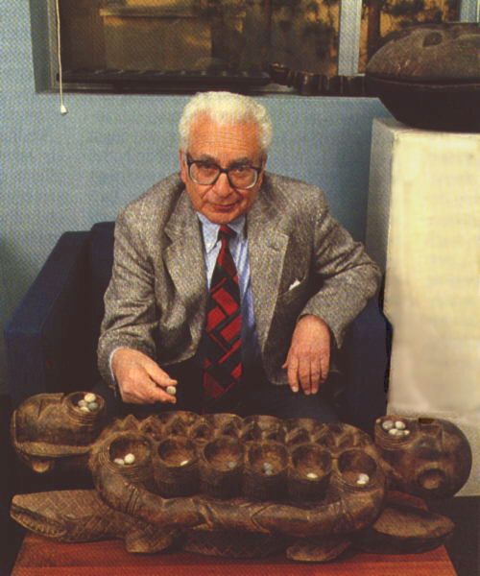
Topic 7: Atomic, nuclear and particle physics 7.3 – The structure of matter
Quarks and their antiparticles
•In 1964 the particle model was looking quite complex and unsatisfying. Murray Gell-Mann proposed a model where all the strong-force particles were made up of three fundamental particles called quarks.
FYI
•A proton is uud and a neutron is udd.
d
proton
u
u
Notes:
© 2006 By Timothy K. Lund

Slide 18
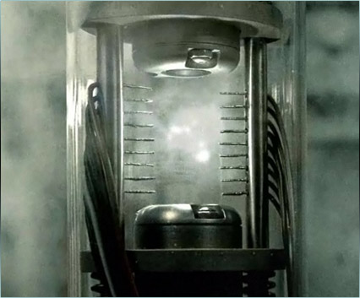
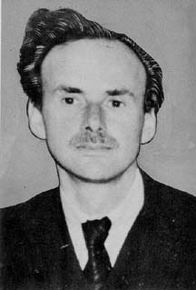
Topic 7: Atomic, nuclear and particle physics 7.3 – The structure of matter
Quarks and their antiparticles
•Every particle has an antiparticle which has the same mass but all of its quantum numbers are the opposite.
•Thus an antiproton (p) has the same mass as a proton (p), but the opposite charge (-1).
•Thus an antielectron (e⁺ or e⁻) has the same mass as an electron but the opposite charge (+1).
Angels and Demons
FYI
•When matter meets antimatter both annihilate each other to become energy!
Paul Dirac
Notes:
18
© 2006 By Timothy K. Lund

Slide 19
Topic 7: Atomic, nuclear and particle physics 7.3 – The structure of matter
Quarks and their antiparticles
•Each quark has an antiquark, which has the opposite charge as the corresponding quark.
•Here are the names of the 6 quarks:
FYI
•An antiquark has the quark symbol, with a bar over it.
•Thus an anti-up quark looks like this: u.
•An alternate way to represent the anti-up quark would be to write “u-bar.”
•Incidentally, this is how you would actually say it.
Notes:
© 2006 By Timothy K. Lund

Slide 20
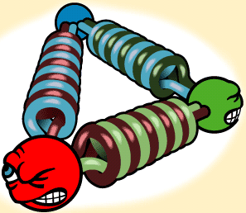
Topic 7: Atomic, nuclear and particle physics 7.3 – The structure of matter
Hadrons, baryons, and mesons
•A hadron is a particle that participates in the strong force.
•A baryon is made of three quarks (qqq). An antibaryon is made of three antiquarks (qqq).
•A meson is made up of a quark and an antiquark (qq):
•Since quarks participate in the strong force, and since baryons and mesons are made of quarks, baryons and mesons are hadrons.
FYI
•A single quark cannot be isolated. We will talk about quark confinement later. Basically, confinement states that you cannot separate a single quark from a hadron.
Notes:
© 2006 By Timothy K. Lund

Slide 21
Topic 7: Atomic, nuclear and particle physics 7.3 – The structure of matter
Protons and neutrons in terms of quarks
•A proton is a baryon made out of two up quarks and a down quark. p = (uud). A proton is a hadron. Why?
•A neutron is a baryon made out of one up quark and two down quarks. n = (udd). A neutron is also a hadron.
EXAMPLE: Show that the charge of a proton is +1, and that the charge of a neutron is 0.
SOLUTION:
•The charge of an up quark is +2/3.
•The charge of a down quark is -1/3.
Thus
Proton = uud : (+2/3) + (+2/3) + (-1/3) = +1.
Neutron = udd : (+2/3) + (-1/3) + (-1/3) = 0.
d
u
u
proton
Notes:
© 2006 By Timothy K. Lund

Slide 22
Topic 7: Atomic, nuclear and particle physics 7.3 – The structure of matter
Conservation of baryon number
•The baryon number B of a quark is +1/3. The baryon number of an antiquark is -1/3.
Quark: B = +1/3
quark (q) or antiquark (q) baryon number B
Antiquark: B = -1/3
PRACTICE: What is the baryon number of a proton and an antiproton? What is the baryon number of a meson?
SOLUTION:
Proton = uud : (+1/3) + (+1/3) + (+1/3) = +1.
Antiproton = uud : (-1/3) + (- 1/3) + (- 1/3) = -1.
A meson has the quark makeup (qq) so that it has a baryon number of (+1/3) + (-1/3) = 0.
FYI •Like charge, baryon number is conserved in all reactions.
Notes:
© 2006 By Timothy K. Lund

Slide 23
Topic 7: Atomic, nuclear and particle physics 7.3 – The structure of matter
Conservation of strangeness
•The strangeness number S of a baryon is related to the number of strange quarks the particle has.
strangeness S
S = # antistrange quarks – # strange quarks
EXAMPLE: The lambda zero particle ( Λ⁰) is a baryon having the quark combo of (uds). What is its charge? What is its strangeness?
SOLUTION: From the table the charges are u = +2/3, d = -1/3 and s = -1/3 so that the total charge is 0.
•From the above formula
S = # antistrange quarks – # strange quarks
= 0 – 1 = -1.
Notes:
© 2006 By Timothy K. Lund

Slide 24
Topic 7: Atomic, nuclear and particle physics 7.3 – The structure of matter
Conservation of strangeness
•The Κ– is a hadron because it is composed of quarks.
Notes:
© 2006 By Timothy K. Lund

Slide 25
Topic 7: Atomic, nuclear and particle physics 7.3 – The structure of matter
Conservation of strangeness
•The proton is composed of uud.
Notes:
© 2006 By Timothy K. Lund

Slide 26
Topic 7: Atomic, nuclear and particle physics 7.3 – The structure of matter
Conservation of strangeness
•If X is sss, then the reaction can be written
su + uud → ds + us + sss.
•The left has an s, u, and d left.
•The right also has an s, u, and d left.
•The quarks are balanced on each side.
Notes:
© 2006 By Timothy K. Lund

Slide 27
Topic 7: Atomic, nuclear and particle physics 7.3 – The structure of matter
Quark confinement
•Quark confinement means that we cannot ever separate a single quark from a baryon or a meson.
•Because of the nature of the strong force holding the quarks together we need to provide an energy that is proportional to the separation.
•Eventually, that energy is so vast that a new quark-antiquark pair forms and all we have is a meson, instead of an isolated quark!
Notes:
© 2006 By Timothy K. Lund

Slide 28
Topic 7: Atomic, nuclear and particle physics 7.3 – The structure of matter
Quark confinement
Original meson
Quark-antiquark pair created from energy needed for separation
Newly-created meson
Notes:
© 2006 By Timothy K. Lund

Slide 29
Topic 7: Atomic, nuclear and particle physics 7.3 – The structure of matter
Leptons and their antiparticles
•You are already familiar with two of the six leptons: the electron and the electron neutrino (of the beta decay reaction).
•Leptons, unlike hadrons (baryons and mesons), do NOT participate in the strong interaction.
FYI
•Of course the leptons also have their antiparticles.
Notes:
© 2006 By Timothy K. Lund

Slide 30
Topic 7: Atomic, nuclear and particle physics 7.3 – The structure of matter
Leptons and their antiparticles
•The leptons interact only via the electromagnetic force carrier, the photon.
•Leptons, unlike quarks, do not react to the gluon.
•Quarks react to both the gluon and the photon.
•Here are the names of the 6 leptons:
FYI
•Leptons and quarks also react to gravitons.
Notes:
© 2006 By Timothy K. Lund

Slide 31
Topic 7: Atomic, nuclear and particle physics 7.3 – The structure of matter
The standard model
●The following graphic shows part of an organizational structure for particles called the standard model.
●These are the quarks from which mesons and hadrons are formed.
FYI
•Particles are divided into “generations” or “families” of increasing mass.
Notes:
© 2006 By Timothy K. Lund

Slide 32
Topic 7: Atomic, nuclear and particle physics 7.3 – The structure of matter
The standard model
●The following graphic shows part of an organizational structure for particles called the standard model.
●These are the leptons, the most common of which is the electron.
FYI
•Muons are created in upper atmosphere by cosmic rays. Tau particles are created in the laboratory.
Notes:
© 2006 By Timothy K. Lund

Slide 33
Topic 7: Atomic, nuclear and particle physics 7.3 – The structure of matter
Leptons and their antiparticles
●Like baryons, leptons also have lepton numbers.
•Lepton number must be conserved by generation.
•In any reaction involving leptons, the total number in each generation must remain the same.
Lepton: L = +1
lepton and antilepton number L
Antilepton: L = -1
Notes:
33
© 2006 By Timothy K. Lund

Slide 34
Topic 7: Atomic, nuclear and particle physics 7.3 – The structure of matter
Applying conservation laws in particle reactions
PRACTICE:
Find the lepton number of an electron, a positron, an antielectron neutrino, an antimuon neutrino, a tau particle, and a proton:
SOLUTION:
•An electron has a lepton number of L_{I} = +1.
•A positron is an antiparticle and so has L_{I} = -1.
•An antielectron neutrino has L_{I} = -1.
•An antimuon neutrino has L_{II} = -1.
•An tau particle has L_{III} = +1.
•A proton is not a lepton and so has L = 0.
FYI
•Note the family/generation-distinguishing subscripts.
Notes:
34
© 2006 By Timothy K. Lund

Slide 35
Topic 7: Atomic, nuclear and particle physics 7.3 – The structure of matter
Applying conservation laws in particle reactions
EXAMPLE: Consider the following reactions. Assign charge, lepton numbers and baryon numbers to each particle to determine the feasibility of each reaction.
p → n + e⁺ + ν_{e}
FEASIBLE
Baryon number:
Lepton number:
Charge:
1 1 + 0 + 0
0 0 + ⁻1_{I} + ⁺1_{I}
1 0 + ⁺1 + 0
=
=
=
n → p + e⁻ + ν_{μ}
NOT FEASIBLE
Baryon number:
Lepton number:
Charge:
1 1 + 0 + 0
0 0 + ⁺1_{I} + ⁻1_{II}
0 1 + ⁻1 + 0
=
≠
=
L must be conserved by family.
n + p → μ⁺ + ν_{μ}
NOT FEASIBLE
Baryon number:
Lepton number:
Charge:
≠
=
=
1 + 1 0 + 0
0 + 0 ⁻1_{II} + 1_{II}
0 + 1 ⁺1 + 0
B must be conserved.
Notes:
© 2006 By Timothy K. Lund

Slide 36
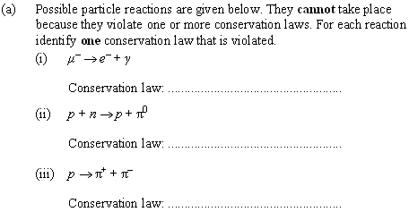
Topic 7: Atomic, nuclear and particle physics 7.3 – The structure of matter
Applying conservation laws in particle reactions
•L must be conserved by family.
•Thus L_{II} and L_{I} are not conserved.
•A pion is a meson and has B = 0.
•p and n each have B = 1.
•Baryon number not conserved.
•Baryon number not conserved.
•Charge not conserved.
Notes:
© 2006 By Timothy K. Lund

Slide 37
Topic 7: Atomic, nuclear and particle physics 7.3 – The structure of matter
Applying conservation laws in particle reactions
•Gluons.
Notes:
© 2006 By Timothy K. Lund

Slide 38
Topic 7: Atomic, nuclear and particle physics 7.3 – The structure of matter
Applying conservation laws in particle reactions
•Conservation of charge.
•Conservation of baryon number.
•Conservation of lepton number (by family).
•Also strangeness, parity, isotopic spin, angular momentum.
Notes:
© 2006 By Timothy K. Lund

Slide 39
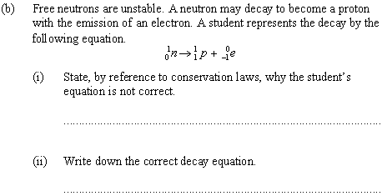
Topic 7: Atomic, nuclear and particle physics 7.3 – The structure of matter
Applying conservation laws in particle reactions
•Family I lepton number is not conserved.
•Equation needs Family I lepton with no charge and L = -1.
ν_{e} fits the bill.
• n → p + e⁻ + ν_{e}.
Notes:
© 2006 By Timothy K. Lund

Slide 40
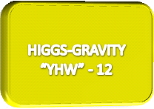
Topic 7: Atomic, nuclear and particle physics 7.3 – The structure of matter
The Higgs boson
•The Higgs boson is another particle that physicists think exists and are in search of.
•This particle is the one that gives quarks and leptons their mass.
•To date the Higgs particle has not been found. (A “Higgs-like” particle was in 2013)
FYI
•CERN and the Large Hadron Collider were developed with the Higgs boson in mind.
Notes:
© 2006 By Timothy K. Lund

Slide 41
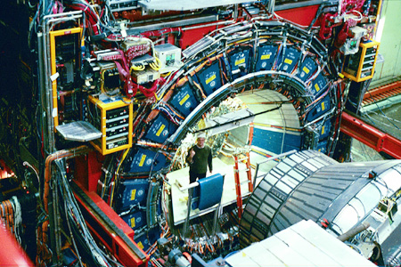
The Large Hadron Collider at CERN.
Notes:
© 2006 By Timothy K. Lund

Slide 42
Topic 7: Atomic, nuclear and particle physics 7.3 – The structure of matter
The Higgs boson – an analogy
•Imagine a room full of physicists. The Higgs field.
•Suddenly Einstein enters and attempts to cross the room, but the star-struck physicists cluster around him and impede his movements, effectively increasing his mass. High-mass particle.
•Now imagine that I enter the room. Nobody wants to interact with me, so I pass through the physicists relatively unimpeded—no effective mass for me! Low-mass (or massless) particle.
•Lastly, imagine that somebody whispers a rumor, causing the physicists to cluster together excitedly on their own. Field disturbance – Higgs boson.
-Burton DeWilde
Notes:
© 2006 By Timothy K. Lund

Slide 43
Topic 7: Atomic, nuclear and particle physics 7.3 – The structure of matter
The Higgs boson – an analogy
Big mass
Small mass
Higgs field
Einstein
Me
Notes:
43
© 2006 By Timothy K. Lund

Slide 44
Topic 7: Atomic, nuclear and particle physics 7.3 – The structure of matter
The Higgs boson
•We call the process whereby mass is not the property of the particle, but part of space itself, the Higgs mechanism.
•For the Higgs mechanism to work, all of space has to be covered by some sort of field called the Higgs field.
•Just as the electromagnetic field has a particle associated with it (a photon) so too does the Higgs field – in this case the particle associated with the Higgs field is the Higgs boson.
•One of the design criteria for CERN was the capability of discovering the Higgs boson (sometimes called the “god” particle).
Notes:
44
© 2006 By Timothy K. Lund

Slide 45
Topic 7: Atomic, nuclear and particle physics 7.3 – The structure of matter
The Higgs boson
•Discovery of the Higgs particle would be evidence that the standard model is correct.
•Without the Higgs particle, the standard model will not extend into the realm of general relativity.
•String theory could be an alternative to the standard model.
•Here is the expected structure of the Higgs field:
Notes:
© 2006 By Timothy K. Lund

Slide 46
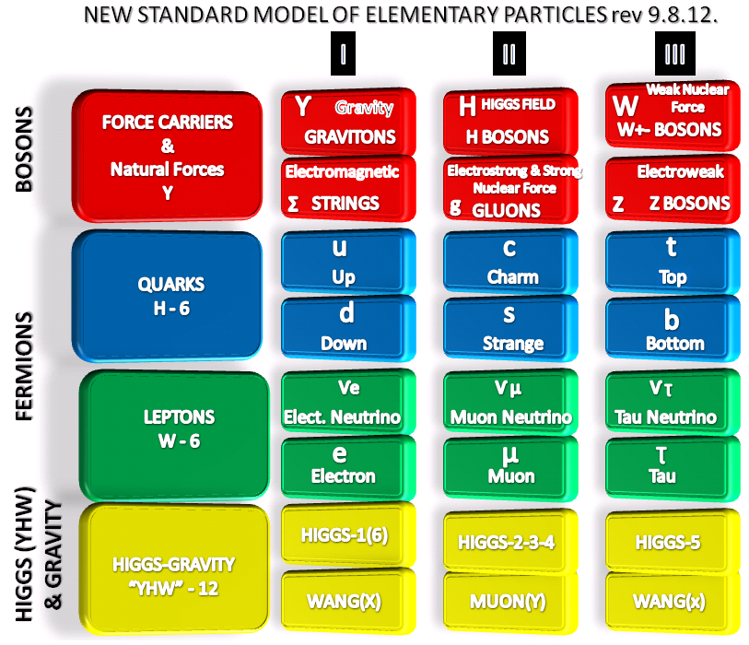

Slide 47
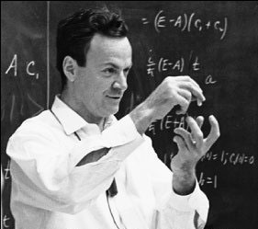
Topic 7: Atomic, nuclear and particle physics 7.3 – The structure of matter
Feynman diagrams
•Richard Feynman developed a graphic representation of particle interactions that could be used to predict the probabilities of the outcomes of particle collisions.
•A typical Feynman diagram consists of two axes: Space and Time:
SPACE
TIME
FYI
•Some books switch the space and time axis. The IB presentation is as shown above.
Notes:
© 2006 By Timothy K. Lund

Slide 48
Topic 7: Atomic, nuclear and particle physics 7.3 – The structure of matter
Feynman diagrams
•Consider two electrons approaching one-another from the top and the bottom of the page…
•A purely spatial sketch of this interaction would look like this:
•But if we also apply a time axis, the sketch would look like this:
•The Time axis allows us to draw the reaction in a spread-out way to make it clearer.
e⁻
The bubble of ignorance
e⁻
e⁻
SPACE
e⁻
e⁻
TIME
FYI
•The “bubble of ignorance” is the actual place in the plot that exchange particles do their thing.
•Ingoing and outgoing particles are labeled.
e⁻
Notes:
© 2006 By Timothy K. Lund

Slide 49
Topic 7: Atomic, nuclear and particle physics 7.3 – The structure of matter
Feynman diagrams
•Particles are represented with straight arrows, as were the two electrons in the previous electron-electron interaction.
•Exchange (force) particles are represented with either wavy lines (photons, W⁺, W⁻ and Z⁰), or curly lines (gluons).
Particle
Electromagnetic and weak exchange
Strong exchange
FYI
•You may have noticed that the electromagnetic exchange particle and the weak exchange particles all have the same wavy symbol.
•Indeed, it has been found that the two forces are manifestations of a single ELECTRO-WEAK force.
Notes:
© 2006 By Timothy K. Lund

Slide 50
Topic 7: Atomic, nuclear and particle physics 7.3 – The structure of matter
Feynman diagrams
e⁻
e⁻
EXAMPLE:
•The complete Feynman diagram showing the repulsion of two electrons looks like this:
EXAMPLE:
•Here is a diagram for one electron emitting a photon:
SPACE
γ
e⁻
e⁻
TIME
e⁻
e⁻
SPACE
γ
TIME
Notes:
© 2006 By Timothy K. Lund

Slide 51
Topic 7: Atomic, nuclear and particle physics 7.3 – The structure of matter
Feynman diagrams
e⁺
e⁺
EXAMPLE:
•In a Feynman diagram, antimatter points backward in time. This diagram represents two positrons repelling each other:
EXAMPLE:
•Here is a diagram for one positron emitting a photon:
SPACE
γ
e⁺
e⁺
TIME
e⁺
e⁺
SPACE
γ
TIME
Notes:
© 2006 By Timothy K. Lund

Slide 52
Topic 7: Atomic, nuclear and particle physics 7.3 – The structure of matter
Feynman diagrams
EXAMPLE:
•Here is a photon producing an electron-positron pair.
EXAMPLE:
•Here is an electron-positron pair annihilating to become a photon:
e⁻
SPACE
γ
e⁺
TIME
e⁺
SPACE
γ
e⁻
TIME
Notes:
© 2006 By Timothy K. Lund

Slide 53
Topic 7: Atomic, nuclear and particle physics 7.3 – The structure of matter
Feynman diagrams
EXAMPLE:
•Here is a diagram of a down quark emitting a W- particle that decays into an electron and an antineutrino:
d
u
ν_{e}
W⁻
SPACE
e⁻
TIME
FYI
•One can use Feynman diagrams to map out complete processes – including the bubble of ignorance. Using the conservation rules and the exchange particles, you can predict what kind of processes can occur.
Notes:
© 2006 By Timothy K. Lund

Slide 54
Topic 7: Atomic, nuclear and particle physics 7.3 – The structure of matter
Feynman diagrams
EXAMPLE: Explain what has happened in this Feynman diagram.
SOLUTION:
•The up quark of a proton (uud) emits a gluon.
•The gluon decays into a down quark and an anti-down quark.
d
d
u
u
u
u
g
d
SPACE
d
TIME
FYI
•Quarks cannot exist by themselves. Thus the two quarks produced above will quickly annihilate.
Notes:
© 2006 By Timothy K. Lund

Slide 55
Topic 7: Atomic, nuclear and particle physics 7.3 – The structure of matter
Feynman diagrams
n
p
EXAMPLE: Explain what has happened in this Feynman diagram.
SOLUTION:
•It is a diagram of a down quark emitting a W⁻ particle that decays into an electron and an antineutrino:
•Recall that a neutron consists of an up-down-down quark combo.
•Recall that a proton consists of an up-up-down quark combo.
•This is non other than the beta decay ( β⁻ ) we talked about a long time ago.
u
u
d
d
d
u
ν_{e}
SPACE
W⁻
e⁻
TIME
n → p + e⁻ + ν_{e}
Notes:
© 2006 By Timothy K. Lund

Slide 56
Topic 7: Atomic, nuclear and particle physics 7.3 – The structure of matter
Feynman diagrams
EXAMPLE: Write the reaction (including the neutrino) for beta (+) decay.
SOLUTION:
•Just know it!
EXAMPLE: Now draw the Feynman diagram for the above β⁺ decay:
p
n
u
u
d
d
u
d
p → n + e⁺ + ν_{e}
ν_{e}
SPACE
W⁺
e⁺
TIME
FYI
•Why is the neutrino not an anti-neutrino as in the β⁻ decay?
•To conserve lepton number.
Notes:
© 2006 By Timothy K. Lund

Slide 57
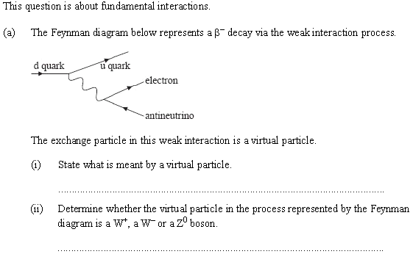
Topic 7: Atomic, nuclear and particle physics 7.3 – The structure of matter
Feynman diagrams
+2/3
Must be -1
-1/3
-1
0
•A virtual particle is a particle that has a very short range of influence.
•Look at charge…
The particle must be a W⁻.
Notes:
© 2006 By Timothy K. Lund

