Slide 1
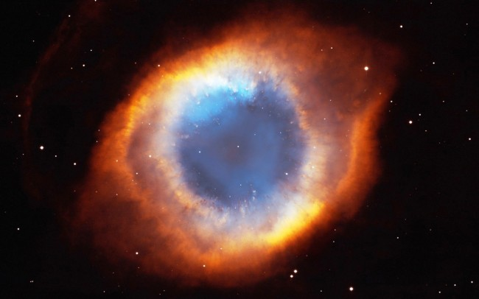
Steller Processes

Slide 2
Understandings
The Jeans criterion
Nuclear fusion
Nucleosynthesis off the main sequence
Type Ia and II supernovae

Slide 3
Applications and Skills
Applying the Jeans criterion to star formation
Describing the different types of nuclear fusion reactions taking place off the main sequence
Applying the mass–luminosity relation to compare lifetimes on the main sequence relative to that of our Sun
Describing the formation of elements in stars that are heavier than iron including the required increases in temperature
Qualitatively describe the s and r processes for neutron capture
Distinguishing between type Ia and II supernovae

Slide 4
Guidance
Only an elementary application of the Jeans criterion is required, ie collapse of an interstellar cloud may begin if M > M_{j}
Students should be aware of the use of type Ia supernovae as standard candles
Data booklet reference:
None!

Slide 5
The Jeans Criterion
Why do some nebulae remain nebulae, but some of them form stars?
It’s all about energy. If a nebula is not very dense, then the potential energy between particles will be near zero. The particles will not be bound together and a star is not likely to form. (KE > PE)
If a nebula is very hot, then even if it is somewhat dense, the particles will be moving too quickly to be drawn together and a star is not likely to be formed. (KE > PE)

Slide 6
The Jeans Criterion
The Jeans criterion simply states that for a star to form from a nebula, the magnitude of the potential energy must be greater than the magnitude of the kinetic energy.
So what does this mean?
A star is likely to form if a nebula is cool and dense. (PE > KE)

Slide 7
Nuclear Fusion in Stars (Main Sequence)
Once force of gravity is strong enough, the molecules are crushed together forming the core of the star. This pressure causes an increase in temperature. When the core gets hot enough, the nuclear fusion process begins.
If the mass of the star is around the mass of our sun, the fusion process will follow the proton-proton chain.

Slide 8
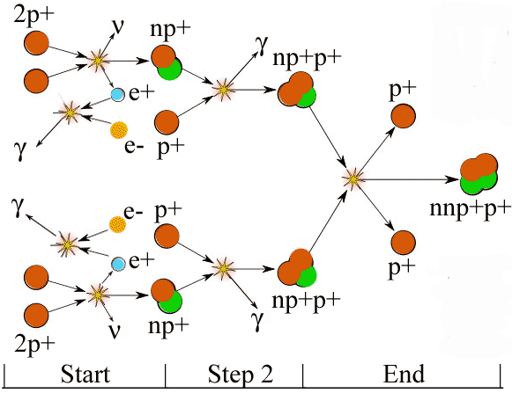
Proton – Proton Chain
http://cseligman.com/text/sun/ppcycle.gif

Slide 9
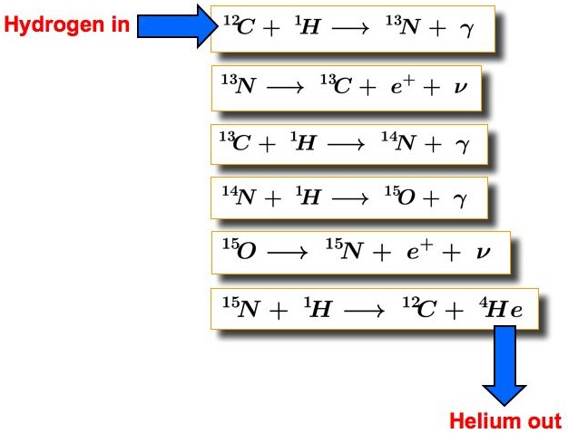
More massive stars and the CNO Cycle
For more massive stars, the fusion cycle looks different, following the CNO cycle.
This cycle is followed because the increase mass leads to increase temperature, facilitating fusion of larger atoms.
http://astronomy.swin.edu.au/cms/cpg15x/albums/userpics/m01a02-s20i01.jpg

Slide 10
After the Main Sequence
Once all of the hydrogen has been used up, the star’s core will contract and get hotter. The higher temperature causes expansion in the outer layers of the star as hydrogen begins to fuse in the outer layers. This is the beginning of the red giant phase.
The core temperature gets hot enough to start the fusion of helium atoms to form unstable beryllium. The beryllium will fuse with another helium to form carbon and then with another helium to form oxygen

Slide 11
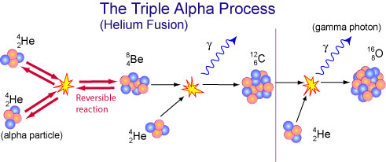
After the Main Sequence
http://www.atnf.csiro.au/outreach//education/senior/astrophysics/images/stellarevolution/triplealphaflash.jpg

Slide 12
When Will It End?
These nucleosynthesis processes will continue with oxygen and carbon undergoing fusion to form silicon, magnesium and heavier elements up to Iron-56. As we discussed before, Iron-56 is very stable and would need to TAKE IN energy for fusion to occur, instead of releasing energy upon fusion.
But there are heavier elements than Iron-56…

Slide 13
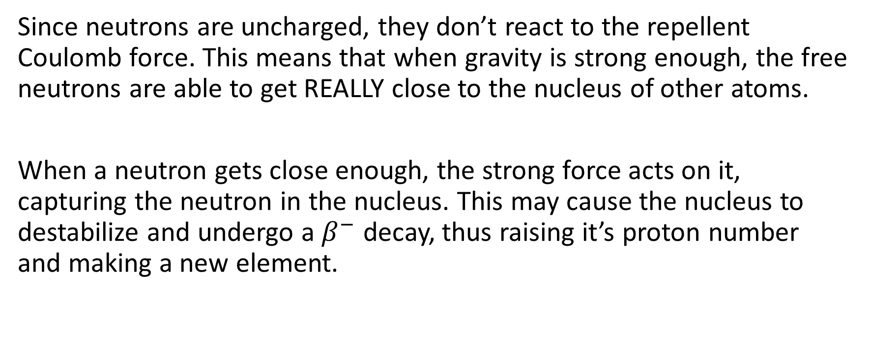
Neutron Capture
Since neutrons are uncharged, they don’t react to the repellent Coulomb force. This means that when gravity is strong enough, the free neutrons are able to get REALLY close to the nucleus of other atoms.
When a neutron gets close enough, the strong force acts on it, capturing the neutron in the nucleus. This may cause the nucleus to destabilize and undergo a $β^{−}$ decay, thus raising it’s proton number and making a new element.

Slide 14
S-Process and R-Process
In massive stars, slow neutron capture can occur in the very aptly named ‘s-process’. This is when there is a fairly small neutron flux and there is time for a $β$decay to occur before any further neutrons are captured in a nucleus.
During a Type II supernova, there is a massive neutron flux. This bombardment of neutrons causes nuclides to undergo rapid neutron capture (‘r-process’). There is not enough time for a $β$ decay to occur before more neutrons are added, creating very heavy isotopes very quickly. Nuclides heavier than bismuth-209 can be created within minutes!

Slide 15
Lifetimes of Main Sequence Stars
It would seem to make sense that the larger the star, the longer the star will live (since it has more fuel for fusion). However this is not true. In fact, it is the exact opposite!
The larger mass requires a higher core temperature to produce more fusion and outward force to counter the inward gravitational force. This increase in fusion rate results in the star running out of hydrogen at the core and completing the main sequence more quickly.

Slide 16
So How Much Time Does She Have?
We discussed the mass-luminosity relationship previously, namely that L $∝$ M^{3.5} . Well, luminosity is just the amount of energy released over time.
$L= \frac{E}{t}$
As energy is lost, a proportion of the mass of the star is also lost. So over the lifetime of a star, the star will lose $κM$ of its mass. We can use Einstein’s equation to show that the total energy lost is:
$E= κMc^{2}$

Slide 17
So How Much Time Does She Have?
If the lifetime of the star is represented by $τ$ then the average luminosity is:
$L= \frac{κMc^{2}}{τ}$
So, $τ= \frac{κMc^{2}}{L}$ , and since L $∝$ M^{3.5} , t$hen τ∝\frac{M}{M^{3.5}}$ or $τ∝ M^{−2.5}$
Often, stars are compared to the lifetime of our sun, yielding the equation:
$$\frac{τ_{star}}{τ_{Sun}}= {\left(\frac{M_{star}}{M_{Sun}}\right)}^{−2.5}$$

Slide 18
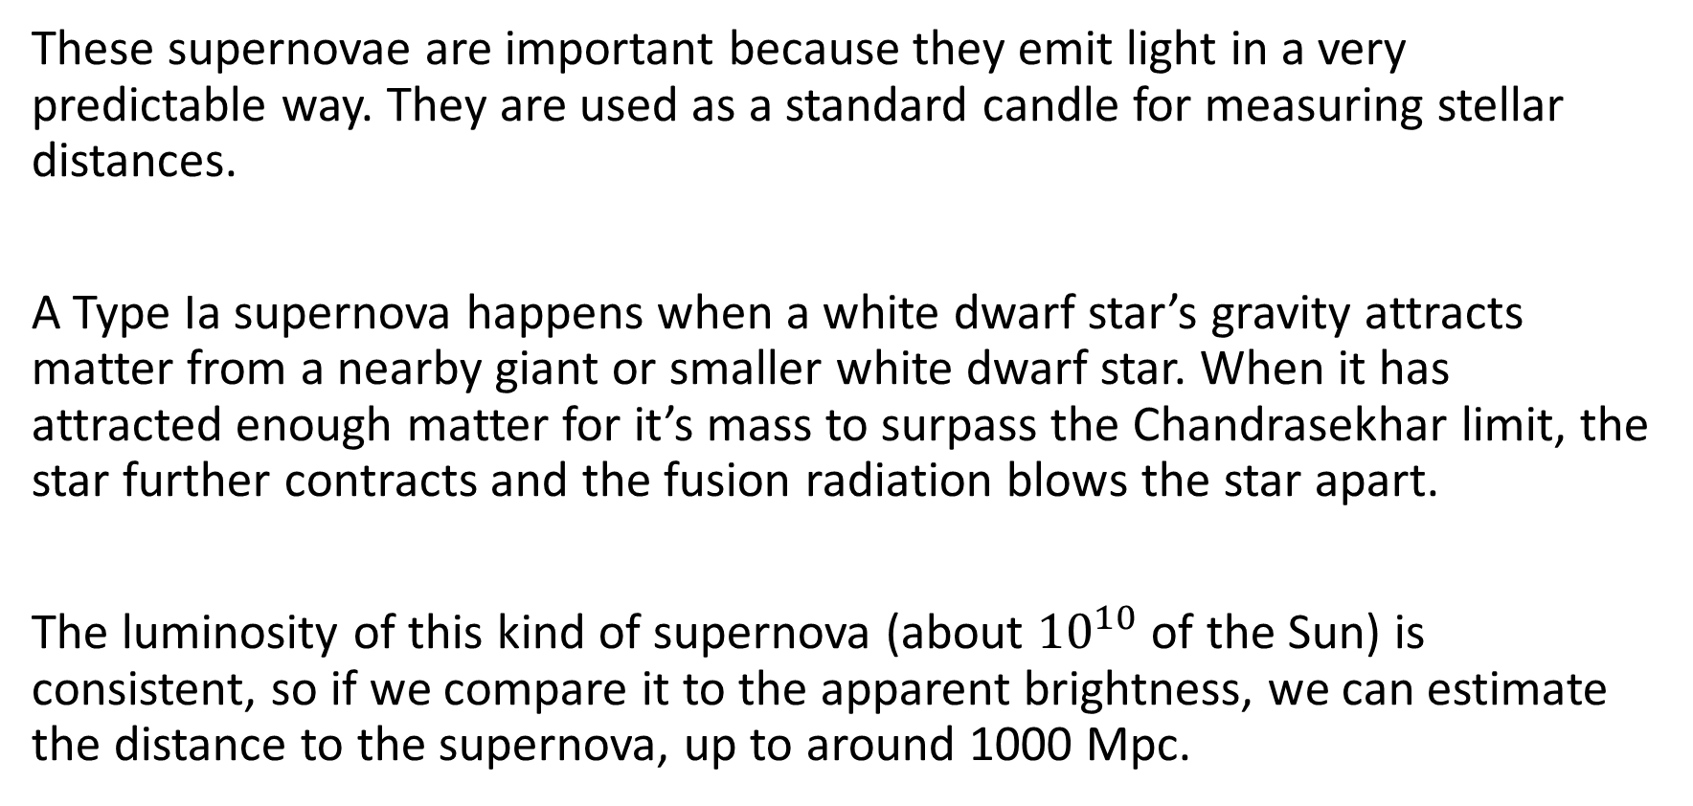
A Thieving White Dwarf! (Type Ia Supernovae )
These supernovae are important because they emit light in a very predictable way. They are used as a standard candle for measuring stellar distances.
A Type Ia supernova happens when a white dwarf star’s gravity attracts matter from a nearby giant or smaller white dwarf star. When it has attracted enough matter for it’s mass to surpass the Chandrasekhar limit, the star further contracts and the fusion radiation blows the star apart.
The luminosity of this kind of supernova (about ${10}^{10}$ of the Sun) is consistent, so if we compare it to the apparent brightness, we can estimate the distance to the supernova, up to around 1000 Mpc.

Slide 19
Type II Supernovae (Cores now Hydrogen Free!)
As discussed before, these supernovae happen when very massive stars have run through their main sequence and all of the hydrogen has been fused at the core. For stars of 8 – 10 solar masses, this takes about 10 million years.
The core undergoes a contraction, increasing the core temperature and starting fusion of larger nuclei (Helium, Carbon, Beryllium). This takes about 10,000 years.
This process continues with heavier and heavier elements and taking less and less time, ending with silicon fusing into Iron-56. This takes only a few days.

Slide 20
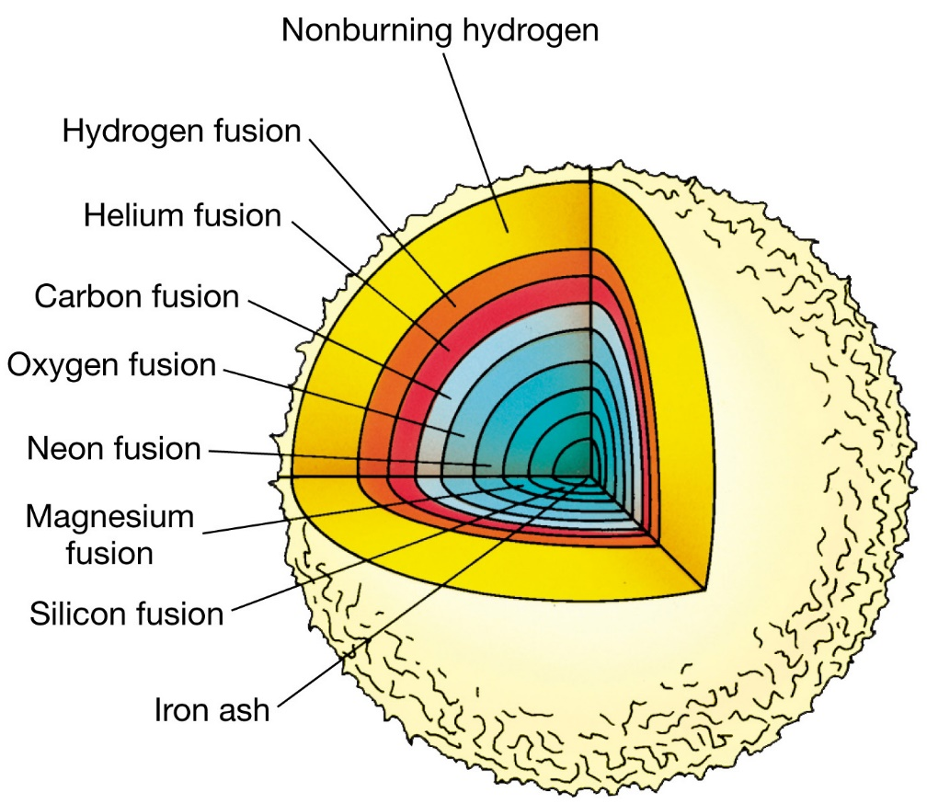
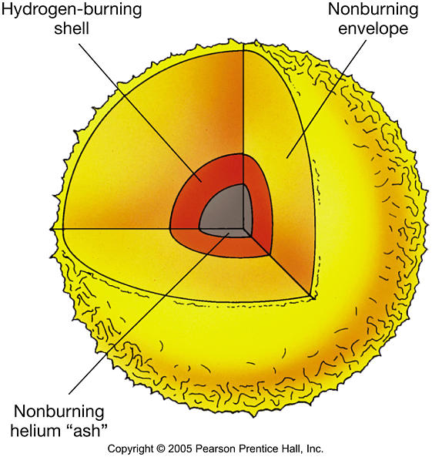
Type II Supernovae continued…
Upon the core reaching a mass of 1.4 solar masses (the Chandrasekhar limit), the electron degeneracy force is overcome, with the core collapsing in and a pressure wave going outward, ripping the star apart.
http://physics.uoregon.edu/~jimbrau/BrauImNew/Chap20/FG20_03.jpg
http://www2.astro.psu.edu/users/cpalma/astro10/Images/FG12_17.JPG

Slide 21
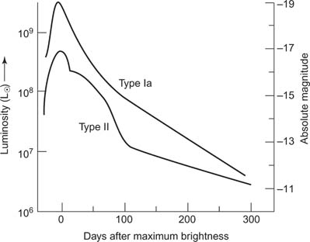
How Can We Tell the Difference?
Type Ia and Type II supernovae can be distinguished by the way they emit light.
http://www.cliffsnotes.com/assets/23429.jpg

