Slide 1
Topic 4: Waves 4.3 – Wave characteristics
Essential idea: All waves can be described by the same sets of mathematical ideas. Detailed knowledge of one area leads to the possibility of prediction in another.
Nature of science: Imagination: It is speculated that polarization had been utilized by the Vikings through their use of Iceland Spar over 1300 years ago for navigation (prior to the introduction of the magnetic compass). Scientists across Europe in the 17th–19th centuries continued to contribute to wave theory by building on the theories and models proposed as our understanding developed.
Notes:
© 2006 By Timothy K. Lund

Slide 2
Topic 4: Waves 4.3 – Wave characteristics
Understandings:
• Wavefronts and rays
• Amplitude and intensity
• Superposition
• Polarization
Notes:
© 2006 By Timothy K. Lund

Slide 3
Topic 4: Waves 4.3 – Wave characteristics
Applications and skills:
• Sketching and interpreting diagrams involving wavefronts and rays
• Solving problems involving amplitude, intensity and the inverse square law
• Sketching and interpreting the superposition of pulses and waves
• Describing methods of polarization
• Sketching and interpreting diagrams illustrating polarized, reflected and transmitted beams
• Solving problems involving Malus’s law
Notes:
© 2006 By Timothy K. Lund

Slide 4
Topic 4: Waves 4.3 – Wave characteristics
Guidance:
• Students will be expected to calculate the resultant of two waves or pulses both graphically and algebraically
• Methods of polarization will be restricted to the use of polarizing filters and reflection from a non-metallic plane surface
Data booklet reference:
• I ∝ A²
• I ∝ x ⁻²
• I = I₀ cos² θ
Notes:
© 2006 By Timothy K. Lund

Slide 5
Topic 4: Waves 4.3 – Wave characteristics
Theory of knowledge:
• Wavefronts and rays are visualizations that help our understanding of reality, characteristic of modelling in the physical sciences. How does the methodology used in the natural sciences differ from the methodology used in the human sciences?
• How much detail does a model need to contain to accurately represent reality?
Utilization:
• A number of modern technologies, such as LCD displays, rely on polarization for their operation
Notes:
© 2006 By Timothy K. Lund

Slide 6
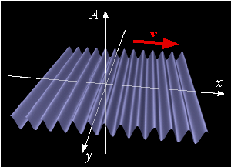
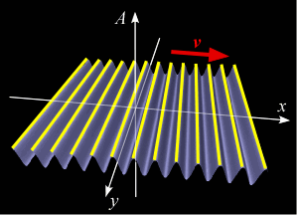
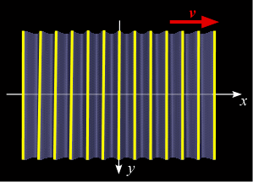
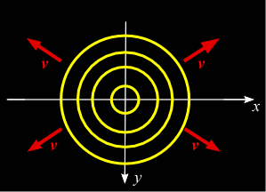
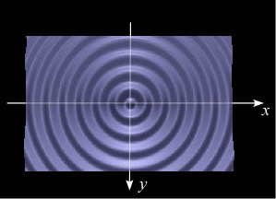
Topic 4: Waves 4.3 – Wave characteristics
Wavefronts and rays
•Consider the transverse waves shown here.
•The __________ are by convention located at the ________ of the waves.
•A top view simplifies the drawing:
•Wavefronts don’t have to be straight.
FYI
•Wavefronts are perpendicular to the wave velocity.
Notes:
© 2006 By Timothy K. Lund

Slide 7
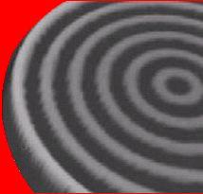
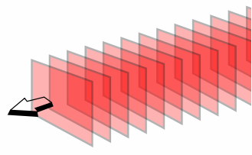
Topic 4: Waves 4.3 – Wave characteristics
Wavefronts and rays
•Wavefronts can also travel in 3D, such as the “cross-section” of the spherical wavefront shown here:
•Such a wave can come from a point source of sound or light, or even from an explosion.
•Even if a wavefront is curved to begin with, as you get farther from the point source the wavefronts become more “flat” or planar.
Notes:
© 2006 By Timothy K. Lund

Slide 8
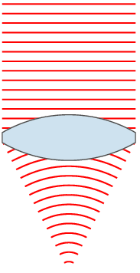
Topic 4: Waves 4.3 – Wave characteristics
Wavefronts and rays
•Wavefronts can also be bent by obstacles in the environment, or by the properties of the medium through which the wave passes:
•The animation shows flat wavefronts being focused by a lens.
•Oftentimes rather than drawing wavefronts we draw _____, which are perpendicular to the wavefronts.
ray
FYI
•Rays are parallel to the wave velocity.
Notes:
© 2006 By Timothy K. Lund

Slide 9
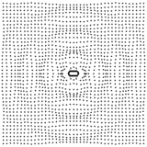
Topic 4: Waves 4.3 – Wave characteristics
Wavefronts and rays
•Longitudinal waves also have wavefronts and rays.
•Instead of crests and troughs, longitudinal waves have compressions and rarefactions.
•Just as crests were arbitrarily chosen to be wavefronts in transverse waves, _______________ are usually chosen as ______________ in longitudinal waves.
FYI
•As always, rays are parallel to the wave velocity.
Notes:
© 2006 By Timothy K. Lund

Slide 10
Topic 4: Waves 4.3 – Wave characteristics
Amplitude and intensity
•_____________ is the rate energy is being transmitted per unit area and is measured in (W m⁻²).
definition of intensity I
EXAMPLE: A 200. watt speaker projects sound in a spherical wave. Find the intensity of the sound at a distance of 1.0 m and 2.0 m from the speaker.
•Note that whatever power is in the wavefront is spread out over a larger area as it expands.
•The area of a sphere of radius x is $A=4πx2$.
•For $x=1$m: $I=\frac{P}{4πx2}=$
•For $x=2$m: I $=\frac{P}{4πx2}=$
Notes:
© 2006 By Timothy K. Lund

Slide 11
Topic 4: Waves 4.3 – Wave characteristics
Amplitude and intensity
•Intensity is the rate energy is being transmitted per unit area and is measured in (W m⁻²).
•Since A = 4πx² for a spherical wave, we can rewrite our intensity formula.
•Recall that the total energy E_{T} of a particle in SHM was E_{T} = ½kx_{MAX}², where x_{MAX} was the amplitude A of the oscillation.
•Since P = $\frac{ET}{time}$, clearly __________so that _________.
•But $I=\frac{power}{area}$so that the following is true:
$$I=\frac{power}{area}$$
definition of intensity I
Intensity I vs. distance x
Intensity I vs. amplitude A
Notes:
11
© 2006 By Timothy K. Lund

Slide 12
Topic 4: Waves 4.3 – Wave characteristics
Solving problems involving amplitude and intensity
EXAMPLE: At a distance of 18.5 m from a sound source the intensity is 2.00×10 ⁻¹ W m⁻².
(a) Find its intensity at a distance of 26.5 m.
SOLUTION: We can just use I ∝ x ⁻² and dispense with finding the actual power as an intermediate step.
•Then I₁ ∝ x₁⁻² and I₂ ∝ x₂⁻² so that
$\frac{I2}{I1} =$
•Thus
$I2=I_{1}\left(\frac{x1}{x2}\right)$
Notes:
12
© 2006 By Timothy K. Lund

Slide 13
Topic 4: Waves 4.3 – Wave characteristics
Solving problems involving amplitude and intensity
EXAMPLE: Continued…
(b) Compare the amplitudes of the sound at 18.5 m and 26.5 m.
SOLUTION: We can use I ∝ A ² and I₁ and I₂.
•Then I₁ ∝ A₁² and I₂ ∝ A₂² so that
$\frac{I1}{I2} =\frac{A12}{A22}$
•Then
$\frac{A1}{A2}=$
Notes:
13
© 2006 By Timothy K. Lund

Slide 14
Topic 4: Waves 4.3 – Wave characteristics
Interpreting diagrams involving reflection
•Wave _____________ occurs when a wave meets a boundary, such as a solid object, or a change in the medium, and is at least partially diverted backwards.
•The angles of the rays are ______________________ _____________ which is _______________________.
•The relationship between the __________________ θ_{incident} and the __________ __________ θ_{reflect} is simple:
incident ray
θ_{incident}
normal
reflective surface
θ_{reflect}
reflected ray
reflected waves
Notes:
© 2006 By Timothy K. Lund

Slide 15
Topic 4: Waves 4.3 – Wave characteristics
Interpreting diagrams involving reflection
•We can also look at the wave fronts: Observe…
•______________________________________________________________________________________.
reflective surface
reflective surface
spherical wavefront
flat or straight wavefront
Notes:
© 2006 By Timothy K. Lund

Slide 16
Topic 4: Waves 4.3 – Wave characteristics
Interpreting diagrams involving refraction
•Wave ___________ occurs when a wave meets a boundary, such as a solid object, or a change in the medium ,and is at least partially allowed through the boundary.
BOUN DARY
REFRACTED WAVE
normal
INCIDENT WAVE
CLEAR WATER
MUDDY WATER
Notes:
© 2006 By Timothy K. Lund

Slide 17
Topic 4: Waves 4.3 – Wave characteristics
Interpreting diagrams involving refraction
•It may help to imagine the ranks of a marching band.
•Obviously, the cadence does not change.
•Thus the period and the frequency do not change.
•But the speed and the wavelength do change.
CONCRETE
DEEP MUD
Notes:
© 2006 By Timothy K. Lund

Slide 18
Topic 4: Waves 4.3 – Wave characteristics
Interpreting diagrams involving refraction
•______________the __________ and the _________ _________________.
•It should be clear that the incident wave is faster than the refracted wave in this example.
BOUN DARY
angle of incidence
REFRACTED WAVE
θ_{incidence}
normal
θ_{refraction}
angle of refraction
INCIDENT WAVE
CLEAR WATER
MUDDY WATER
Notes:
© 2006 By Timothy K. Lund

Slide 19
Topic 4: Waves 4.3 – Wave characteristics
Superposition – constructive interference
•Wave ______________ is simply the _____________ more waves passing simultaneously through a medium.
•Superposition is also called ____________ and can be _________________________, or anything in between.
•Consider two in-phase pulses coming from each end of a taut rope.
•The amplitudes x₀ of the two pulses add together, producing a momentary pulse of amplitude 2x₀.
2x₀
x₀
constructive interference
0
Notes:
© 2006 By Timothy K. Lund

Slide 20
Topic 4: Waves 4.3 – Wave characteristics
Superposition – destructive interference
•Wave superposition is simply the addition of two or more waves passing simultaneously through a medium.
•Superposition is also called interference and can be constructive or destructive, or anything in between.
•Consider two 180° out-of-phase pulses coming from each end of a taut rope.
•The amplitudes x₀ of the two pulses cancel, producing a momentary pulse of amplitude 0.
x₀
0
destructive interference
- x₀
Notes:
© 2006 By Timothy K. Lund

Slide 21
Topic 4: Waves 4.3 – Wave characteristics
Superposition
PRACTICE: Two pulses are shown in a string approaching each other at 1 m s⁻¹.
Sketch diagrams to show each of the following:
(a) The shape of the string at exactly t = 0.5 s later.
(b) The shape of the string at exactly t = 1.0 s later.
1 m
1 m
1 m
Notes:
© 2006 By Timothy K. Lund

Slide 22
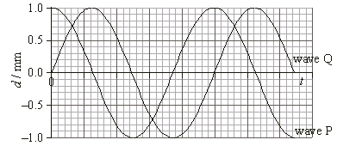
Topic 4: Waves 4.3 – Wave characteristics
Superposition
EXAMPLE:
Two waves P and Q reach the same point at the same time, as shown in the graph.
The amplitude of the resulting wave is
0.0 mm. B. 1.0 mm. C. 1.4 mm. D. 2.0 mm.
Notes:
© 2006 By Timothy K. Lund

Slide 23
Topic 4: Waves 4.3 – Wave characteristics
Superposition
EXAMPLE: Fourier series are examples of the superposition principle. You can create any waveform by summing up sine waves!
y
5
y = Σ y_{n}
1
5π
1
2
y₅ = - sin 5ωt
n=1
1
4
0
t
T
2T
1
4
-
1
2
1
3π
-
y₃ = - sin 3ωt
1
4π
y₄ = - sin 4ωt
1
2π
y₂ = - sin 2ωt
1
1π
y₁ = - sin ωt
Notes:
© 2006 By Timothy K. Lund

Slide 24
Topic 4: Waves 4.3 – Wave characteristics
Polarization
•In _______________ the oscillations are _______________ to the direction of the propagation of the traveling wave.
•On the other hand, ________________ oscillate parallel to the direction of motion.
•________________ can have __________________ _____________, each of which is perpendicular to the propagation, whereas longitudinal can only have a single mode.
•Because of these allowed modes, the phenomenon of _________________________________________.
•In this subtopic we will consider only one transverse wave, namely electromagnetic waves, or light.
Notes:
© 2006 By Timothy K. Lund

Slide 25
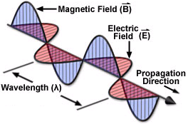
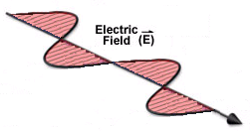
Topic 4: Waves 4.3 – Wave characteristics
Polarization
•______________________ _______________________ _______________________ _______________________ ______________________.
•Note that electromagnetic radiation consists of ____________________________ __________________________________________.
FYI
•In this subtopic we will consider polarization in terms of the ____________, not the magnetic field.
Notes:
© 2006 By Timothy K. Lund

Slide 26
Topic 4: Waves 4.3 – Wave characteristics
Polarization
•Sketching the electric field itself is simplified even more:
•If we look at the ray diagram from the edge of its plane (at edge A) this is what we draw:
•If we look at the ray diagram from the edge of a perpendicular plane (at edge B) this is what we draw:
B
A
View from Point A
View from Point B
Notes:
© 2006 By Timothy K. Lund

Slide 27
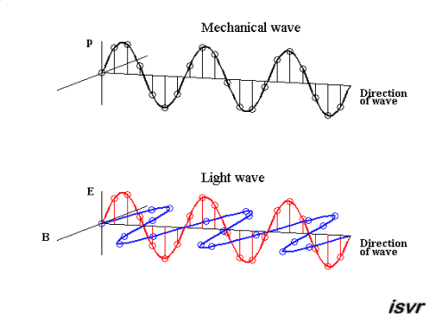
Topic 4: Waves 4.3 – Wave characteristics
Polarization
•An oscillating electric charge produces an electromagnetic wave.
•For a light source such as the sun, or a glowing gas, or an incandescent filament, the charges can __________ ___ any direction, thus __________________________ _________________________________________.
c
Notes:
© 2006 By Timothy K. Lund

Slide 28
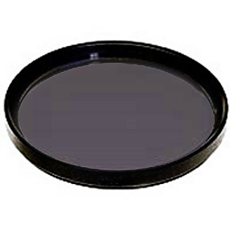
Topic 4: Waves 4.3 – Wave characteristics
Polarization
•Random orientations of electric fields in a light source constitute ___________________ light.
•Rather than drawing the E-fields along the whole length of the ray, we can simplify our sketch by just showing the fields at a single point:
•A manmade film call ____________ can take unpolarized light, and ___________________________ ____________________________________.
•The E-fields of the _____________________ are all __________________________ and the light is said to be _____________.
Unpolarized light
Unpolarized light (simplified view)
Polaroid filter
Notes:
© 2006 By Timothy K. Lund

Slide 29
Topic 4: Waves 4.3 – Wave characteristics
Polarization
EXAMPLE: If unpolarized light is passed through the Polaroid film it will absorb all the rays not oriented with the film.
•Polaroid is not the only way to polarize light. For example, ____________________________________ ____________________________________________________________________.
•In general, the object used to polarize unpolarized light is called a ___________.
Polaroid film
linearly-polarized light
unpolarized light
POLARIZER
Notes:
© 2006 By Timothy K. Lund

Slide 30
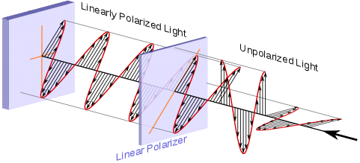
Topic 4: Waves 4.3 – Wave characteristics
Polarization
EXAMPLE: This is a view of unpolarized light passing through a linear polarizer. (The light is traveling from right to left.)
FYI
•_________________ is also called _______________.
Notes:
© 2006 By Timothy K. Lund

Slide 31
Topic 4: Waves 4.3 – Wave characteristics
Polarization
first filter
LIGHT
EXAMPLE: Two Polaroid filters are placed in a beam of unpolarized light.
Explain why when the second filter is rotated through 90º, the intensity of the light passing through the pair decreases to zero.
•The first filter ________________________________.
•The second filter, originally oriented to allow passage, ____________________________________________.
second filter
Analyzer
Polarizer
FYI
•The first filter is called the ____________, and the second filter is called the _____________.
Notes:
31
© 2006 By Timothy K. Lund

Slide 32
Observe the light intensity through two polarizing filters as the top one is rotated through 180º.
Which filter is the analyzer?
Which filter is the polarizer?
BLACK FILTER
RED FILTER
Notes:
32
© 2006 By Timothy K. Lund

Slide 33
Topic 4: Waves 4.3 – Wave characteristics
Solving problems involving Malus’s law
•In general, polarizing filters are sketched with lines showing the orientation of the E-field allowed through:
•Note that the analyzer is rotated (rather than the polarizer).
•θ is the angle between the orientations of polarizer P and analyzer A.
A
θ
P
Notes:
33
© 2006 By Timothy K. Lund

Slide 34
Topic 4: Waves 4.3 – Wave characteristics
Solving problems involving Malus’s law
•Recall that the intensity of a wave is proportional to the square of its amplitude.
•Thus the intensity of the light that comes out of the analyzer is proportional to (E cos θ)².
Malus’s law
polarized light E (from polarizer)
direction of allowed E-field (by analyzer)
θ
θ
E
E cos θ
angle through which analyzer has been turned
E-field allowed to pass
Notes:
34
© 2006 By Timothy K. Lund

Slide 35
Topic 4: Waves 4.3 – Wave characteristics
Solving problems involving Malus’s law
PRACTICE: The preferred directions of two sheets of Polaroid are initially parallel.
(a) Calculate the angle through which one sheet needs to be turned in order to reduce the amplitude of the observed E-field to half its original value.
(b) Calculate the effect this rotation has on the intensity.
(c) Calculate the rotation angle needed to halve the intensity from its original value.
SOLUTION:
Notes:
35
© 2006 By Timothy K. Lund

Slide 36
Topic 4: Waves 4.3 – Wave characteristics
Solving problems involving Malus’s law
Notes:
36
© 2006 By Timothy K. Lund

Slide 37
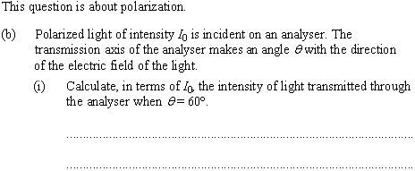
Topic 4: Waves 4.3 – Wave characteristics
Solving problems involving Malus’s law
Notes:
37
© 2006 By Timothy K. Lund

Slide 38
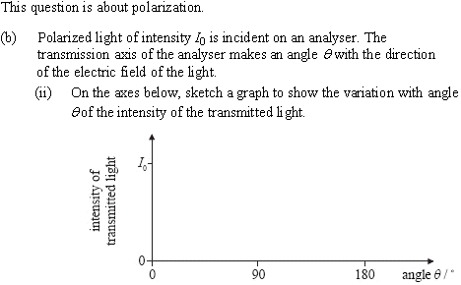
Topic 4: Waves 4.3 – Wave characteristics
Solving problems involving Malus’s law
Notes:
38
© 2006 By Timothy K. Lund

Slide 39
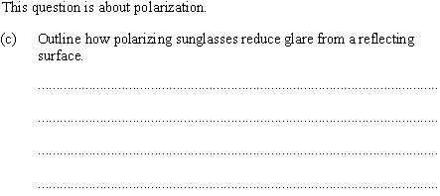
Topic 4: Waves 4.3 – Wave characteristics
Solving problems involving Malus’s law
Notes:
39
© 2006 By Timothy K. Lund

Slide 40
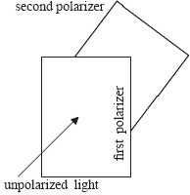
Topic 4: Waves 4.3 – Wave characteristics
Solving problems involving Malus’s law
Notes:
40
© 2006 By Timothy K. Lund

Slide 41
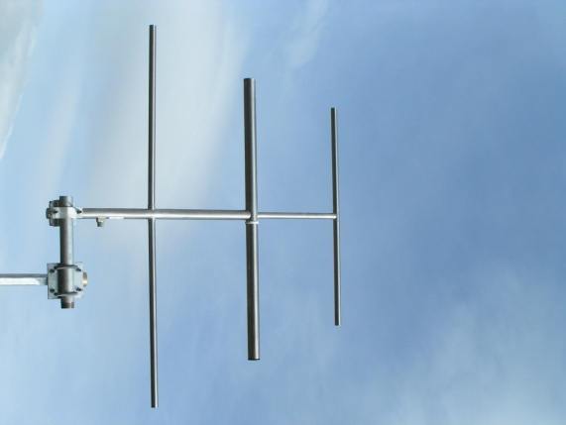
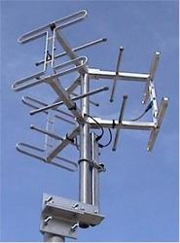
Topic 4: Waves 4.3 – Wave characteristics
Polarization
•There are ways other than Polaroid film to obtain polarized light.
•Some EM radiation is polarized when it is produced. For example, EM waves used for television are often polarized either horizontally or vertically, depending on the arrangement of the aerials.
•Circularly polarized light can be constructed from two polarized rays.
•Reflection of unpolarized light from a boundary between two mediums can polarize light.
•Transmission of polarized light through certain liquids can change the polarization angle.
Notes:
© 2006 By Timothy K. Lund

Slide 42
Topic 4: Waves 4.3 – Wave characteristics
Polarization by reflection
EXAMPLE: Besides a Polaroid filter, there are other ways to polarize light. One way is by reflecting light from a surface between two media where you get reflection and refraction.
θ_{inc}
θ_{refl}
FYI
•Polarization occurs parallel to the surface between the two media and varies with angle of incidence.
θ_{refr}
Notes:
© 2006 By Timothy K. Lund

Slide 43
Topic 4: Waves 4.3 – Wave characteristics
Polarization by reflection – Brewster’s law.
•It turns out that _______________________________ _______________ then the ______________________ ____________________________.
•The particular angle of incidence at which this total polarization occurs is called ________________.
Brewster’s law
PRACTICE: Use the simplified method to draw an unpolarized incident ray becoming completely polarized by reflection.
FYI •Also, recall that θ_{inc} = θ_{refl}.
Notes:
© 2006 By Timothy K. Lund

Slide 44
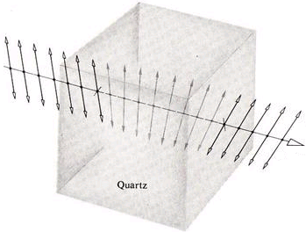
Topic 4: Waves 4.3 – Wave characteristics
Polarization – optical activity
•A substance is termed ______________ if _________ ________________________________________________________. A sugar solution is an example of such a substance. So is quartz.
•The angle through which the plane rotates depends on the concentration of the solution (if the substance can be made into a solution), and the distance through which the light passes.
α
Notes:
44
© 2006 By Timothy K. Lund

Slide 45
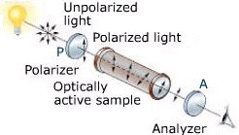
Topic 4: Waves 4.3 – Wave characteristics
Polarization uses – polarimeters
PRACTICE: Data for various concentrations of sugar solution have been gathered for a sample tube of fixed length.
(a) Plot a suitable graph to represent the data.
SOLUTION:
C/g cm⁻³
Angle of rotation α / º | Concentration C / g cm⁻³
5 | 0.08
10 | 0.17
15 | 0.23
0.30
0.20
0.10
5
10
15
20
α/º
Notes:
45
© 2006 By Timothy K. Lund

Slide 46
Topic 4: Waves 4.3 – Wave characteristics
Polarization uses – polarimeters
PRACTICE: Data for various concentrations of sugar solution have been gathered for a sample tube of fixed length.
(b) Find the concentration of a sugar solution having α = 18º.
SOLUTION:
Polarimeter
C/g cm⁻³
0.30
0.20
FYI
•The above apparatus is called a _____________.
0.10
5
10
15
20
α/º
Notes:
46
© 2006 By Timothy K. Lund

Slide 47
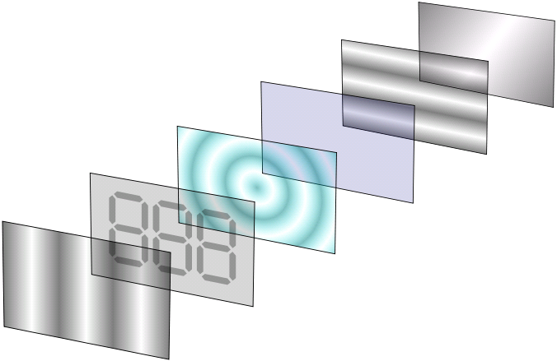
Topic 4: Waves 4.3 – Wave characteristics
Polarization uses – liquid crystal displays
•Liquid crystals (LC) are optically active substances whose activity can be controlled by applying a potential difference across them.
•If there is no p.d. across the LC it will not be optically active.
•If there is a p.d. across the LC it will rotate the light through 90º.
Second polarizer
Reflector
Common electrode
Liquid crystal
Shaped electrode
Unpolarized light
First polarizer
FYI
•The LCD is illuminated by ambient unpolarized light from the external environment.
Notes:
47
© 2006 By Timothy K. Lund

Slide 48
Topic 4: Waves 4.3 – Wave characteristics
Polarization uses – liquid crystal displays
•The light is polarized by the first polarizer.
•If there is no p.d. it will continue through to the second polarizer at which point it will be completely absorbed because of the cross polarization.
•It is then reflected back to the viewer as black.
Second polarizer
Reflector
Common electrode
Liquid crystal
Shaped electrode
Unpolarized light
First polarizer
FYI •An LCD projector replaces the reflector with a light source.
Notes:
48
© 2006 By Timothy K. Lund

Slide 49
Topic 4: Waves 4.3 – Wave characteristics
Polarization uses – liquid crystal displays
•If there is a p.d. across the LC, it will become optically active.
•The LC will then rotate the polarized light from the first polarizer an additional 90º.
•This action aligns it with the second polarizer, which now allows it to pass through unhindered.
Second polarizer
Reflector
Common electrode
Liquid crystal
Shaped electrode
Unpolarized light
First polarizer
FYI
•The image received by the eye will have the shape determined by the shaped electrode.
Notes:
49
© 2006 By Timothy K. Lund

Slide 50
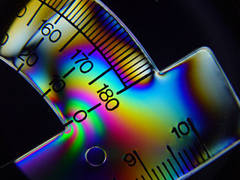
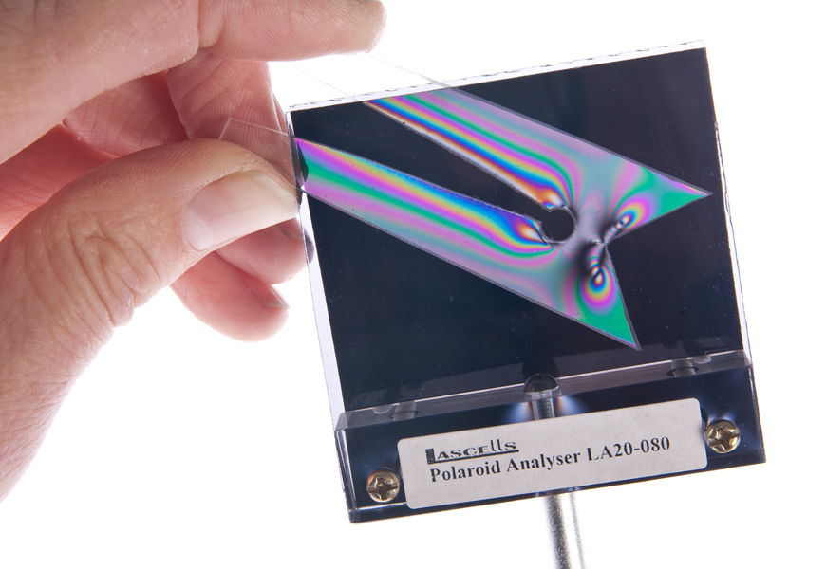
Topic 4: Waves 4.3 – Wave characteristics
Polarization uses – stress analyzers
•When stressed, glass and plastics develop optical properties that are dependent on the plane of polarization.
•When placed between a polarizer and an analyzer, and illuminated by white light, the regions of highest stress will appear as colored lines.
Notes:
50
© 2006 By Timothy K. Lund

