Slide 1
Topic 3: Thermal physics 3.2 – Modeling a gas
Essential idea: The properties of ideal gases allow scientists to make predictions of the behaviour of real gases.
Nature of science: Collaboration: Scientists in the 19th century made valuable progress on the modern theories that form the basis of thermodynamics, making important links with other sciences, especially chemistry. The scientific method was in evidence with contrasting but complementary statements of some laws derived by different scientists. Empirical and theoretical thinking both have their place in science and this is evident in the comparison between the unattainable ideal gas and real gases.
Notes:
© 2006 By Timothy K. Lund

Slide 2
Topic 3: Thermal physics 3.2 – Modeling a gas
Understandings:
• Pressure
• Equation of state for an ideal gas
• Kinetic model of an ideal gas
• Mole, molar mass and the Avogadro constant
• Differences between real and ideal gases
Applications and skills:
• Solving problems using the equation of state for an ideal gas and gas laws
• Sketching and interpreting changes of state of an ideal gas on pressure–volume, pressure–temperature and volume–temperature diagrams
• Investigating at least one gas law experimentally
Notes:
© 2006 By Timothy K. Lund

Slide 3
Topic 3: Thermal physics 3.2 – Modeling a gas
Guidance:
• Students should be aware of the assumptions that underpin the molecular kinetic theory of ideal gases
• Gas laws are limited to constant volume, constant temperature, constant pressure and the ideal gas law
• Students should understand that a real gas approximates to an ideal gas at conditions of low pressure, moderate temperature and low density
Data booklet reference:
• $p=\frac{F}{A}$
• $n=\frac{N}{N_{A}}$
• $pV=nRT$ • $\overline{E_{K}}=\left(\frac{3}{2}\right)kBT=\left(\frac{3}{2}\right)\frac{RT}{N_{A}}$
Notes:
© 2006 By Timothy K. Lund

Slide 4
Topic 3: Thermal physics 3.2 – Modeling a gas
Theory of knowledge:
• When does modelling of “ideal” situations become “good enough” to count as knowledge?
Utilization:
• Transport of gases in liquid form or at high pressures/densities is common practice across the globe. Behaviour of real gases under extreme conditions needs to be carefully considered in these situations.
• Consideration of thermodynamic processes is essential to many areas of chemistry (see Chemistry sub-topic 1.3)
• Respiration processes (see Biology sub-topic D.6)
Notes:
© 2006 By Timothy K. Lund

Slide 5
Topic 3: Thermal physics 3.2 – Modeling a gas
Aims:
• Aim 3: this is a good topic to make comparisons between empirical and theoretical thinking in science
• Aim 6: experiments could include (but are not limited to): verification of gas laws; calculation of the Avogadro constant; virtual investigation of gas law parameters not possible within a school laboratory setting
Notes:
© 2006 By Timothy K. Lund

Slide 6
Topic 3: Thermal physics 3.2 – Modeling a gas
Pressure
•Consider a gas molecule confined in a closed box as shown.
•Since the molecule’s direction is always changing, it is accelerating, and thus feeling a force from the walls of the box.
•From Newton’s third law, the molecule is exerting an equal and opposite force on the walls of the box.
•The walls of the box feel a pressure p, given by the formula below:
•From the formula we can see that the units of pressure are (N m⁻²), also known as Pascals (Pa).
$$p=\frac{F}{A}$$
pressure
Notes:
© 2006 By Timothy K. Lund

Slide 7
Topic 3: Thermal physics 3.2 – Modeling a gas
Pressure
$$p=\frac{F}{A}$$
pressure
PRACTICE:
A 150-kg man stands on one foot on some ice. Given that his foot is about 9.0 cm by 10. cm in rectangular cross-section, find the pressure on the ice.
SOLUTION:
•First, find the force:
$F=mg=150(9.8)=1470$N
•Then find the area:
$A=LW=(.09)(.10)=0.009$m².
•Finally
$p=\frac{F}{A}=\frac{1470}{0.009}= 160000$N m⁻² = $160000$ Pa.
Notes:
© 2006 By Timothy K. Lund

Slide 8
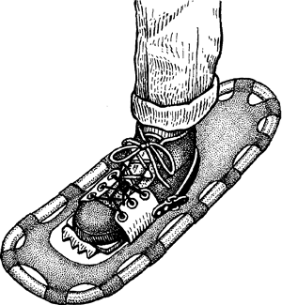
Topic 3: Thermal physics 3.2 – Modeling a gas
Pressure
$$p=\frac{F}{A}$$
pressure
PRACTICE:
If the ice is thin enough that it will break under a pressure of 1.0×10⁵ Pa, what should be the area of a snowshoe that will just prevent him from breaking through when on one foot?
SOLUTION:
•From $p=\frac{F}{A}$we have:
$A=\frac{F}{p}=\frac{1470}{100000}$
$=0.015$m².
Notes:
© 2006 By Timothy K. Lund

Slide 9
Topic 3: Thermal physics 3.2 – Modeling a gas
The kinetic model of an ideal gas
•An ideal gas is an imaginary gas that is used to model real gases, and has the following properties:
Notes:
© 2006 By Timothy K. Lund

Slide 10
Topic 3: Thermal physics 3.2 – Modeling a gas
The kinetic model of an ideal gas
•Just as temperature was a measure of the random kinetic energy of molecules for solids and liquids, so it is for an ideal gas.
•If the temperature of a gas increases, so does the average speed (and hence kinetic energy) of the molecules.
low T
medium T
high T
Notes:
© 2006 By Timothy K. Lund

Slide 11
Topic 3: Thermal physics 3.2 – Modeling a gas
The kinetic model of an ideal gas
•Looking at this animation again we can see that if the speed of the molecules increases, then the number of collisions with the container walls will also increase.
•Thus the pressure will increase if the temperature increases.
low T
medium T
high T
low p
medium p
high p
Notes:
© 2006 By Timothy K. Lund

Slide 12
Topic 3: Thermal physics 3.2 – Modeling a gas
The kinetic model of an ideal gas
•Consider small, medium and large containers.
•In a smaller volume the molecules have less distance to travel to hit a wall. Thus the wall is hit more often.
•Thus the pressure will be bigger if the volume is smaller.
small V
medium V
high p
large V
medium p
low p
Notes:
© 2006 By Timothy K. Lund

Slide 13
Topic 3: Thermal physics 3.2 – Modeling a gas
The kinetic model of an ideal gas
•Consider a syringe full of an ideal gas.
•If we make the volume less we see that the temperature will increase.
•Since the plunger exerts a force on the gas, and executes a displacement, it does work on the gas.
•From the work-kinetic energy theorem we know that if we do work on the gas, its kinetic energy must increase.
•Thus its speed will increase, which means its temperature increases.
•On the other hand, if the process is reversed the gas will do the work, lose E_{K} and cool.
Notes:
© 2006 By Timothy K. Lund

Slide 14
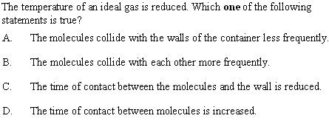
Topic 3: Thermal physics 3.2 – Modeling a gas
The kinetic model of an ideal gas
•Temperature is a measure of the E_{K} of the gas.
•Reducing the E_{K} reduces the frequency of collisions.
•For perfectly elastic collisions (as in an ideal gas) contact time is zero regardless of E_{K.}
Notes:
14
© 2006 By Timothy K. Lund

Slide 15
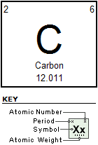
Topic 3: Thermal physics 3.2 – Modeling a gas
The mole and molar mass
•Recall from the periodic table of the elements that each element has certain numbers associated with it.
•We define the mole of a homogeneous substance as follows:
1 mole is the number of atoms of an element that will have a mass in grams equal to its gram atomic weight.
definition of mole and molar mass
EXAMPLE: Find the mass (in kg) of one mole of carbon.
SOLUTION:
From the periodic table we see that it is just 1 mole C = 12.011 grams = 0.012011 kg.
Notes:
© 2006 By Timothy K. Lund

Slide 16
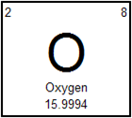
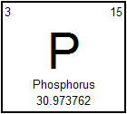
Topic 3: Thermal physics 3.2 – Modeling a gas
The mole and molar mass
PRACTICE:
What is the gram atomic weight of oxygen?
SOLUTION:
It is $15.9994 g$, or if you prefer,
$\left(15.9994 g\right)\left(\frac{1kg}{1000g}\right)=0.015994$ kg.
PRACTICE:
What is the molar mass of phosphorus in kilograms?
•From the periodic table we see that the molar mass of phosphorus is $30.973762$ grams.
•The molar mass in kilograms is $0.030973762$ kg.
Notes:
© 2006 By Timothy K. Lund

Slide 17
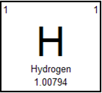
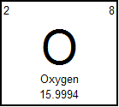
Topic 3: Thermal physics 3.2 – Modeling a gas
The mole and molar mass
PRACTICE: Water is made up of 2 hydrogen atoms and 1 oxygen atom and has a molecular formula given by H₂O. Find
the gram atomic weight of water.
(b) the mass in grams of 1 mole of water.
(c) how many moles of hydrogen and oxygen there are in 1 mole of water.
SOLUTION:
(a) The GAW of H₂O is given by
2(1.00794) + 1(15.9994) = 18.01528 g per mole.
(b) Thus the mass of 1 mole of H₂O is 18.01528 g.
(c) Since each mole of H₂O has 2H and 1O, there are 2 moles of H and 1 mole of O for each mole of water.
Notes:
© 2006 By Timothy K. Lund

Slide 18
Topic 3: Thermal physics 3.2 – Modeling a gas
The mole and molar mass
PRACTICE:
Suppose we have 12.25 g of water in a DixieTM Cup? How many moles of water does this amount to?
SOLUTION:
•We determined that the GAW of H₂O is 18.01528 g per mole in the previous problem.
•Thus
$\left(12.25g\right)\left(\frac{1 mol}{18.01528g}\right)=0.6800$mol.
FYI
•Maintain your vigilance regarding significant figures!
Notes:
© 2006 By Timothy K. Lund

Slide 19
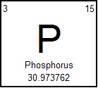
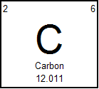
Topic 3: Thermal physics 3.2 – Modeling a gas
The Avogadro constant
•It turns out the a mole of carbon (12 g) and a mole of phosphorus (31 g) has the same number of atoms.
•This means that 30.973762 g of P has the same number of atoms and 12.011 g of C.
•That number, N_{A} , is given here:
N_{A} = 6.02×10²³ molecules.
the Avogadro constant
EXAMPLE: How many atoms of P are there in 31.0 g of it? How many atoms of C are there in 12.0 g of it?
SOLUTION:
There are N_{A} = 6.02×10²³ atoms of P in 31.0 g of it.
There are N_{A} = 6.02×10²³ atoms of C in 12.0 g of it.
Notes:
© 2006 By Timothy K. Lund

Slide 20
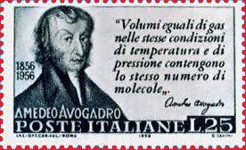
Topic 3: Thermal physics 3.2 – Modeling a gas
The Avogadro constant
•To find the number of atoms in a sample, simply convert sample to moles, then use the conversion
1 mol = 6.02×10²³ molecules.
N_{A} = 6.02×10²³ molecules.
the Avogadro constant
EXAMPLE: How many atoms of P are there in 145.8 g of it?
SOLUTION: It is best to start with the given quantity.
$\left(145.8g\right)\left(\frac{1mol}{30.984g}\right)\left(\frac{6.02×1023 atoms}{1mol}\right)$
$$=2.831024 atoms$$
Notes:
© 2006 By Timothy K. Lund

Slide 21
Topic 3: Thermal physics 3.2 – Modeling a gas
The Avogadro constant
•To find the number of moles n in a sample containing N atoms, use this formula:
$$n=\frac{N}{NA}$$
the molar ratio
EXAMPLE: A sample of carbon has 1.28×10²⁴ atoms as counted by Marvin the Paranoid Android.
a) How many moles is this?
b) What is its mass?
SOLUTION: It is best to start with the given quantity.
a) $\left(1.28×1024 atoms\right)\left(\frac{1mol}{6.02×1023 atoms}\right)= 2.13 mol$.
b) $\left(2.13 mol\right)\left(\frac{12.011g}{mol}\right) = 25.5$ g of C.
Notes:
21
© 2006 By Timothy K. Lund

Slide 22
Topic 3: Thermal physics 3.2 – Modeling a gas
Equation of state for an ideal gas
•Without proof, here is the equation of state for an ideal gas.
•We will explain what an ideal gas is a bit later...
•The variables p (pressure), V (volume), n (number of moles), and T (temperature) are all called the four state variables.
•p is measured in Pascals or Nm⁻².
•V is measured in m³.
•T is measured in K.
pV = nRT
equation of state of an ideal gas
R = 8.31 J / mol·K is the universal gas constant
Notes:
© 2006 By Timothy K. Lund

Slide 23
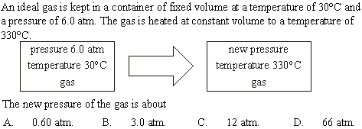
Topic 3: Thermal physics 3.2 – Modeling a gas
Equation of state for an ideal gas
•Use pV = nRT.
p_{i}V_{i} = nRT_{i},
p_{f}V_{f} = nRT_{f}.
•From T(K) = T(°C) + 273
$$\frac{p_{f}V_{f}}{p_{i}V_{i}}=\frac{nRT_{f}}{nRT_{i}}$$
T_{i} = 30 + 273 = 303 K.
T_{f} = 330 + 273 = 603 K.
$$pf=\frac{p_{i}T_{f}}{T_{i}}=\frac{\left(6\right)\left(603\right)}{303}=12$$
•V_{i} = V_{f}.
Notes:
23
© 2006 By Timothy K. Lund

Slide 24
Topic 3: Thermal physics 3.2 – Modeling a gas
Equation of state for an ideal gas
•For an ideal gas use pV = nRT.
•WANTED: n, the number of moles.
• GIVEN: p = 20×10⁶ Pa, V = 2.0×10⁻² m³.
•From T(K) = T(°C) + 273
T(K) = 17 + 273 = 290 K.
•Then $n=\frac{pV}{RT}=\frac{\left(20×{10}^{6}\right)\left(2×{10}^{−2}\right)}{\left(8.31\right)\left(290\right)}$
$n=170$mol.
Notes:
24
© 2006 By Timothy K. Lund

Slide 25
Topic 3: Thermal physics 3.2 – Modeling a gas
Equation of state for an ideal gas
•Use $n=\frac{N}{NA}$where $NA=6.021023$atoms / mol.
•Then N = n N_{A}.
N = 170 mol ×
6.02×10²³ atoms
mol
N = 1.0×10²⁶ atoms.
Notes:
25
© 2006 By Timothy K. Lund

Slide 26
Topic 3: Thermal physics 3.2 – Modeling a gas
Differences between real and ideal gases
•Recall the properties of an ideal gas:
•The kinetic theory of gases is, of course, a model.
•As such, it doesn’t apply perfectly to real gases.
Notes:
© 2006 By Timothy K. Lund

Slide 27
Topic 3: Thermal physics 3.2 – Modeling a gas
Differences between real and ideal gases
• Here are the properties of a real gas.
FYI
•Real gases are often polyatomic (N₂, O₂, H₂O, NH₄, etc.) and thus not spherical.
•Ideal gases cannot be liquefied, but real gases have intermolecular forces and non-zero volume, so they can be liquefied.
Notes:
© 2006 By Timothy K. Lund

Slide 28
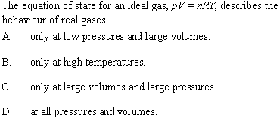
Topic 3: Thermal physics 3.2 – Modeling a gas
Differences between real and ideal gases
•Under high pressure or low volume real gases’ intermolecular forces come into play.
•Under low pressure or large volume real gases’ obey the equation of state.
Notes:
28
© 2006 By Timothy K. Lund

Slide 29
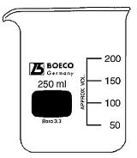
Topic 3: Thermal physics 3.2 – Modeling a gas
Constant pressure process – isobaric process
•In an isobaric process, p does not change.
•As an example of an isobaric experiment, suppose we take a beaker that is filled with an ideal gas, and stopper it with a gas-tight, frictionless cork and a weight, as shown.
•The weight F causes a pressure in the gas having a value given by p = F / A, where A is the area of the cork in contact with the gas.
•If we now heat up the gas it will expand against the cork, pushing it upward:
•Since neither F nor A change, p remains constant.
∆V
x
A
Notes:
© 2006 By Timothy K. Lund

Slide 30
Topic 3: Thermal physics 3.2 – Modeling a gas
Constant pressure process – work done by a gas
•From the previous slide: $p=\frac{F}{A} → F=pA$.
•From the picture note that ΔV = Ax.
•Recall the work W done by the gas is just the force F it exerts on the weighted cork times the displacement x it moves the cork. Thus
W = Fx = pAx = pΔV.
F
∆V
x
A
W = p∆V
work done by expanding gas (constant p)
FYI
•If ∆V > 0 (gas expands) then W > 0.
•If ∆V < 0 (gas contracts) then W < 0.
Notes:
© 2006 By Timothy K. Lund

Slide 31
Topic 3: Thermal physics 3.2 – Modeling a gas
Constant pressure process – isobaric process
EXAMPLE: Show that for an isolated ideal gas V ∝ T during an isobaric process.
SOLUTION: Use $pV=nRT$. Then
$V=\left(\frac{nR}{p}\right)T$.
•Isolated means n is constant (no gas is added to or lost from the system).
•Isobaric means p is constant.
•Then n and P are constant (as is R). Thus
$V=\left(\frac{nR}{p}\right)T=(CONST)T$
$V ∝ T$. ( isobaric process )
FYI - The symbol ∝ means “is proportional to.”
Notes:
© 2006 By Timothy K. Lund

Slide 32
Topic 3: Thermal physics 3.2 – Modeling a gas
Constant volume process – isovolumetric process
•In an isovolumetric process, V does not change.
•We have already seen an isovolumetric experiment when we studied the concept of absolute zero:
•During an isovolumetric process the temperature and the pressure change.
•Note that the volume was kept constant in this experiment.
p
10
20
0
30
T (°C)
-300
-200
-100
0
100
200
300
Notes:
© 2006 By Timothy K. Lund

Slide 33
Topic 3: Thermal physics 3.2 – Modeling a gas
Constant volume process – isovolumetric process
EXAMPLE:
Show that for an isolated ideal gas p ∝ T during an isovolumetric process.
SOLUTION: Use $pV=nRT$. Then
$p=\left(\frac{nR}{V}\right)T$.
•Isolated means n is constant (no gas is added to or lost from the system).
•Isovolumetric means that V is constant.
•Then n and V are constant (as is R). Thus
$p=\left(\frac{nR}{V}\right)T=(CONST)T$
$p ∝ T$. ( isovolumetric process )
FYI •Isovolumetric is sometimes called isochoric.
Notes:
© 2006 By Timothy K. Lund

Slide 34
Why do we wait before recording our values?
Topic 3: Thermal physics 3.2 – Modeling a gas
Constant temperature process –isothermal process
•In an isothermal process, T does not change.
EXAMPLE: A graduated syringe which is filled with air is placed in an ice bath and allowed to reach the temperature of the water. Demonstrate that
p₁V₁ = p₂V₂.
SOLUTION:
•Record initial states after a wait:
p₁ = 15, V₁ = 10, and T₁ = 0ºC.
•Record final states after a wait:
p₂ = 30, V₂ = 5, and T₂ = 0ºC.
p₁V₁ = 15(10) = 150.
p₂V₂ = 30(5) = 150.
•Thus p₁V₁ = p₂V₂.
10
20
0
30
Notes:
© 2006 By Timothy K. Lund

Slide 35
Topic 3: Thermal physics 3.2 – Modeling a gas
Constant temperature process –isothermal process
PRACTICE:
Show that for an isolated ideal gas p₁V₁ = p₂V₂ during an isothermal process.
SOLUTION:
•From pV = nRT we can write
p₁V₁ = nRT₁
p₂V₂ = nRT₂.
•Isolated means n is constant.
•Isothermal means T is constant so T₁ = T₂ = T.
•Obviously R is constant.
•Thus
p₁V₁ = nRT = p₂V₂. ( isothermal )
Notes:
© 2006 By Timothy K. Lund

Slide 36
Topic 3: Thermal physics 3.2 – Modeling a gas
Sketching and interpreting state change graphs
•Perhaps you have enjoyed the pleasures of analytic geometry and the graphing of surfaces in 3D.
•The three variables of a surface are x, y, and z, and we can describe any surface using the "state" variables x, y, and z:
•The “equation of state” of a sphere is x² + y² + z² = r², where r is the radius of the sphere.
z
y
x
FYI
•We “built” the 3D sphere with layers of 2D circles.
•We have transformed a 3D surface into a stack of 2D surfaces.
Notes:
© 2006 By Timothy K. Lund

Slide 37
Topic 3: Thermal physics 3.2 – Modeling a gas
p
Sketching and interpreting state change graphs
•The three state variables of a gas (if n is kept constant) are analogous.
•We can plot the three variables p, V, and T on mutually perpendicular axes like this:
•We have made layers in T. Thus each layer has a single temperature.
V
T₄
T₃
T₂
T₁
T
p
isotherms
T₄
T₃
FYI
•Each layer is an isotherm.
•The 3D graph (above) can then be redrawn in its simpler 2D form (below) without loss of information.
T₂
T₁
V
Notes:
© 2006 By Timothy K. Lund

Slide 38
Topic 3: Thermal physics 3.2 – Modeling a gas
Sketching and interpreting state change graphs
•A thermodynamic process involves moving from one state to another state. This could involve changing any or even all of the state variables (p, V, or T).
EXAMPLE: In the p-V graph shown, identify each process type as ISOBARIC, ISOTHERMAL, OR ISOVOLUMETRIC (isochoric).
SOLUTION:
•A→B is isothermal (constant T).
•B→C is isobaric (constant p).
•C→A is isochoric (constant V).
•We will only have two states change at a time. Phew!
p
A
isotherm
B
C
D
isotherm
V
FYI •The purple line shows all three states changing.
Notes:
© 2006 By Timothy K. Lund

Slide 39
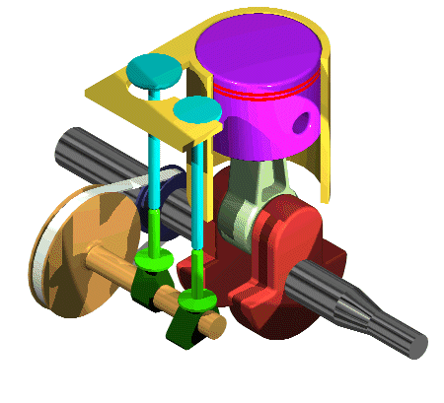
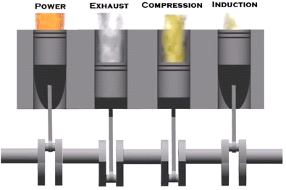
Topic 3: Thermal physics 3.2 – Modeling a gas
Sketching and interpreting state change graphs
EXAMPLE: An internal combustion engine is an example of a heat engine that does useful work on the environment. A four-stroke engine is animated here.
•This example illustrates how a gas can be made to do work and illustrates a thermodynamic cycle.
http://www.animatedengines.com/otto.html
http://chemcollective.org/activities/simulations/engine
Notes:
© 2006 By Timothy K. Lund

Slide 40
Topic 3: Thermal physics 3.2 – Modeling a gas
Sketching and interpreting state change graphs
•A thermodynamic cycle is a set of processes which ultimately return a gas to its original state.
EXAMPLE: A fixed quantity of a gas undergoes a cycle by changing between the following three states:
State A: (p = 2 Pa, V = 10 m³)
State B: (p = 8 Pa, V = 10 m³)
State C: (p = 8 Pa, V = 25 m³)
Each process is a straight line, and the cycle goes like this: A→B→C→A.
Sketch the complete cycle on a p-V diagram.
SOLUTION:
•Scale your axes and plot your points…
p
8
B
C
2
A
V
10
25
Notes:
© 2006 By Timothy K. Lund

Slide 41
Topic 3: Thermal physics 3.2 – Modeling a gas
Sketching and interpreting state change graphs
EXAMPLE: A fixed quantity of a gas undergoes the cycle shown here (from the last example):
(a) Find the work done during the process A→B.
(b) Find the work done during the process B→C.
SOLUTION: Use W = pΔV.
(a) From A to B:
ΔV = 0. Thus the W = 0.
(b) From B to C:
ΔV = 25 – 10 = 15;
p = 8.
Thus W = pΔV = 8(15) = 120 J.
p
8
B
C
2
A
V
10
25
Notes:
© 2006 By Timothy K. Lund

Slide 42
Topic 3: Thermal physics 3.2 – Modeling a gas
Sketching and interpreting state change graphs
EXAMPLE: A fixed quantity of a gas undergoes the cycle shown here (from the last example):
(c) Find the work done during the process C→A.
SOLUTION:
•Observe that ∆V is negative when going from C (V = 25) to A (V = 10).
•Observe that p is NOT constant so W ≠ p∆V.
•W = $Area under the p−V diagram$.
= $−\left[\left(2\right)\left(15\right)+\left(\frac{1}{2}\right)\left(6\right)\left(15\right)\right]$
= - 75 J.
p
8
B
C
2
A
V
10
25
Notes:
42
© 2006 By Timothy K. Lund

Slide 43
Topic 3: Thermal physics 3.2 – Modeling a gas
Sketching and interpreting state change graphs
EXAMPLE: A fixed quantity of a gas undergoes the cycle shown here (from the last example):
(d) Find the work done during the cycle A→B→C→A.
SOLUTION:
(d) Just total up the work done in each process.
•W_{A→B} = 0 J.
•W_{B→C} = +120 J.
•W_{C→A} = -75 J.
•W_{cycle} = 0 + 120 – 75 = +45 J.
p
8
B
C
2
A
V
10
25
FYI •Because W_{cycle} is positive, work is done on the external environment during each cycle.
Notes:
43
© 2006 By Timothy K. Lund

Slide 44
Topic 3: Thermal physics 3.2 – Modeling a gas
Sketching and interpreting state change graphs
PRACTICE:
Find the total work done if the previous cycle is reversed.
SOLUTION:
•We want the cycle A→C→B→A.
•W_{A→C} = Area
= $\left[\left(2\right)\left(15\right)+\left(\frac{1}{2}\right)\left(6\right)\left(15\right)\right]=+75$J.
•W_{C→B} = $P∆V=8\left(10–25\right)=−120$J.
•W_{B→A} = $0$ J (since $∆V=0$).
•W_{cycle} = $75−120+0=−45$J.
p
8
B
C
2
A
V
10
25
FYI •Reversing the cycle reverses the sign of the work.
Notes:
44
© 2006 By Timothy K. Lund

Slide 45
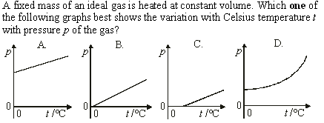
Topic 3: Thermal physics 3.2 – Modeling a gas
Sketching and interpreting state change graphs
•Fixed mass and constant volume means n and V are constant. Thus
•$pV=nRT$
→ $p=\left(\frac{nR}{V}\right)T$
→ $p=(CONST)T$. (**LINEAR**)
•Since the t axis is in ºC, but T is in Kelvin, the horizontal intercept must be NEGATIVE…
Notes:
© 2006 By Timothy K. Lund

Slide 46
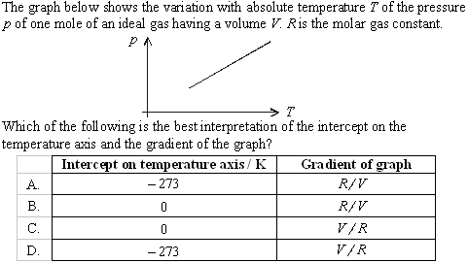
Topic 3: Thermal physics 3.2 – Modeling a gas
Sketching and interpreting state change graphs
•$p=0$at absolute zero.
•From $pV=nRT$:
•$p=\left(\frac{1R}{V}\right)T$:
Notes:
© 2006 By Timothy K. Lund

Slide 47
Topic 3: Thermal physics 3.2 – Modeling a gas
Average kinetic/internal energy of an ideal gas
•Since ideal gases have no intermolecular forces, their internal energy is stored completely as kinetic energy.
•The individual molecules making up an ideal gas all travel at different speeds:
•Without proof, the average kinetic energy E_{K} of each ideal gas molecule has the following forms:
•k_{B} is called the Boltzmann constant.
$$EK=\left(\frac{3}{2}\right)kBT=\frac{3RT}{2N_{A}}$$
Average kinetic energy of ideal gas
Where k_{B} = 1.38×10⁻²³ J K⁻¹.
Notes:
47
© 2006 By Timothy K. Lund

Slide 48
Topic 3: Thermal physics 3.2 – Modeling a gas
Average kinetic/internal energy of an ideal gas
$$EK=\left(\frac{3}{2}\right)kBT=\frac{3RT}{2N_{A}}$$
Average kinetic energy of ideal gas
Where k_{B} = 1.38×10⁻²³ J K⁻¹.
EXAMPLE: 2.50 moles of hydrogen gas is contained in a fixed volume of 1.25 m³ at a temperature of 175 °C.
a) What is the average kinetic energy of each atom?
b) What is the total internal energy of the gas?
SOLUTION: T(K) = 175 + 273 = 448 K.
a) $\overline{E_{K}}=\left(\frac{3}{2}\right)kBT =\left(\frac{3}{2}\right)(1.38×{10}^{−23})(448)=9.27×{10}^{−21}$ J.
b) From $n=\frac{N}{NA}$we get $N=nNA$.
$N=\left(2.50 mol\right)\left(\frac{6.02×1023 atoms}{mol}\right) = 1.51×1024$atm.
$EK=N\overline{E_{K}}=(1.51×1024)(9.27×{10}^{−21}) = 14000$J.
Notes:
48
© 2006 By Timothy K. Lund

Slide 49
Topic 3: Thermal physics 3.2 – Modeling a gas
Average kinetic/internal energy of an ideal gas
$$EK=\left(\frac{3}{2}\right)kBT=\frac{3RT}{2N_{A}}$$
Average kinetic energy of ideal gas
Where k_{B} = 1.38×10⁻²³ J K⁻¹.
EXAMPLE: 2.50 moles of hydrogen gas is contained in a fixed volume of 1.25 m³ at a temperature of 175 °C.
c) What is the pressure of the gas at this temperature?
SOLUTION: T(K) = 175 + 273 = 448 K.
c) Use $pV=nRT$: Then
$p=\frac{nRT}{V}$
$=\frac{\left(2.50\right)\left(8.31\right)\left(448\right)}{1.25}$
$= 7450$Pa.
Notes:
49
© 2006 By Timothy K. Lund

